Slide 1





THE SART SALE PREDICTION
PREPROCESS THE DATA, DEFINE AND TRAIN YOUR MODEL, GENERATE PREDICTIONS, AND SUBMIT THEM FOR EVALUATION ON THE COMPETITION PLATFORM

Slide 2
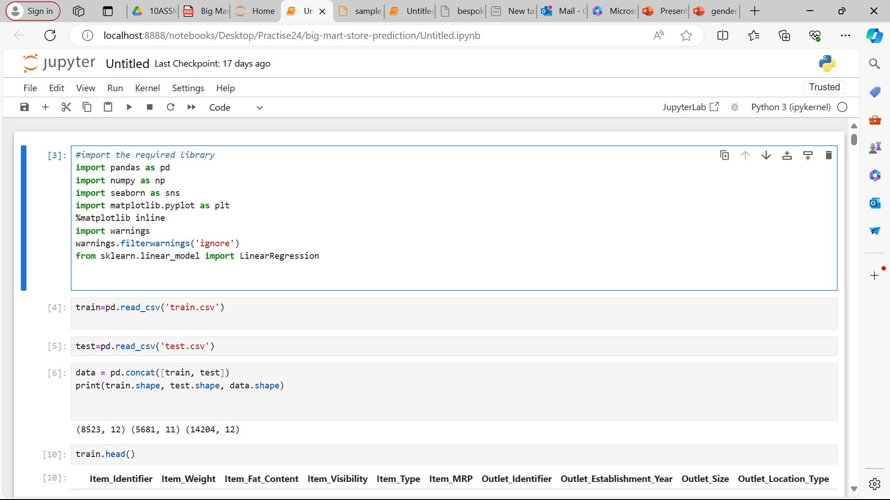
IMPPORTING LIBRARIES AND FUNCTIONS
NumPy is a common step in data analysis and manipulation tasks in Python.
Pandas data manipulation, analysis, and numerical computations in Python
Glob provides a convenient way to search for files matching a specified pattern
matplotlib.pyplois a common convention in the Python data visualization community
Plt inline allows you to see the plots alongside your code
Inputlayer represents the input to your neural network where you feed your data into the network

Slide 3

RECAP IMPPRTING LIBRARIES
Dense : This layer represents a fully connected layer in a neural network. Each neuron in a dense layer is connected to every neuron in the previous layer.
Keras, a Sequential model is a linear stack of layers. You can add layers to this model one by one, and each layer will feed its output to the next layer in the sequence.
mporting a function from scikit-learn (sklearn) that is commonly used for splitting datasets into training and testing sets.
useful in machine learning tasks for dividing your dataset into two subsets: one for training your model and another for testing its performance

Slide 4
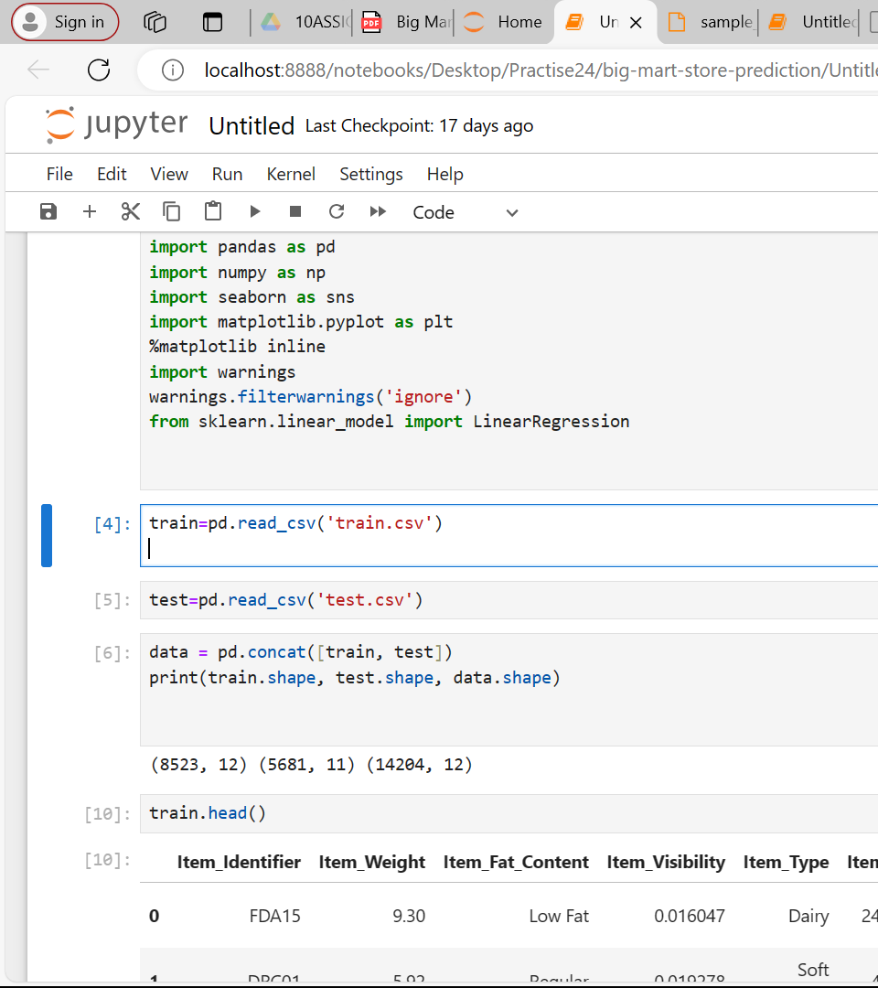
LOAD DATA
LOAD DATA TRAIN AND TEST TO DATAFRAME FROM CSV FILE

Slide 5
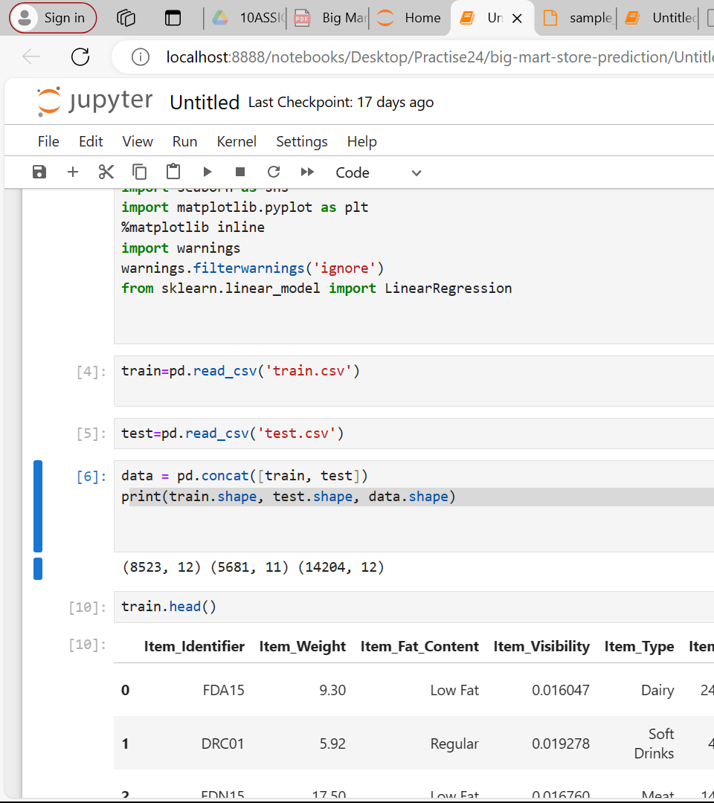
Load data to one dataframe
The command pd.concat([train, test]) is used to concatenate two DataFrame objects, train and test, into a single DataFrame. In this context, pd is an alias for the pandas

Slide 6
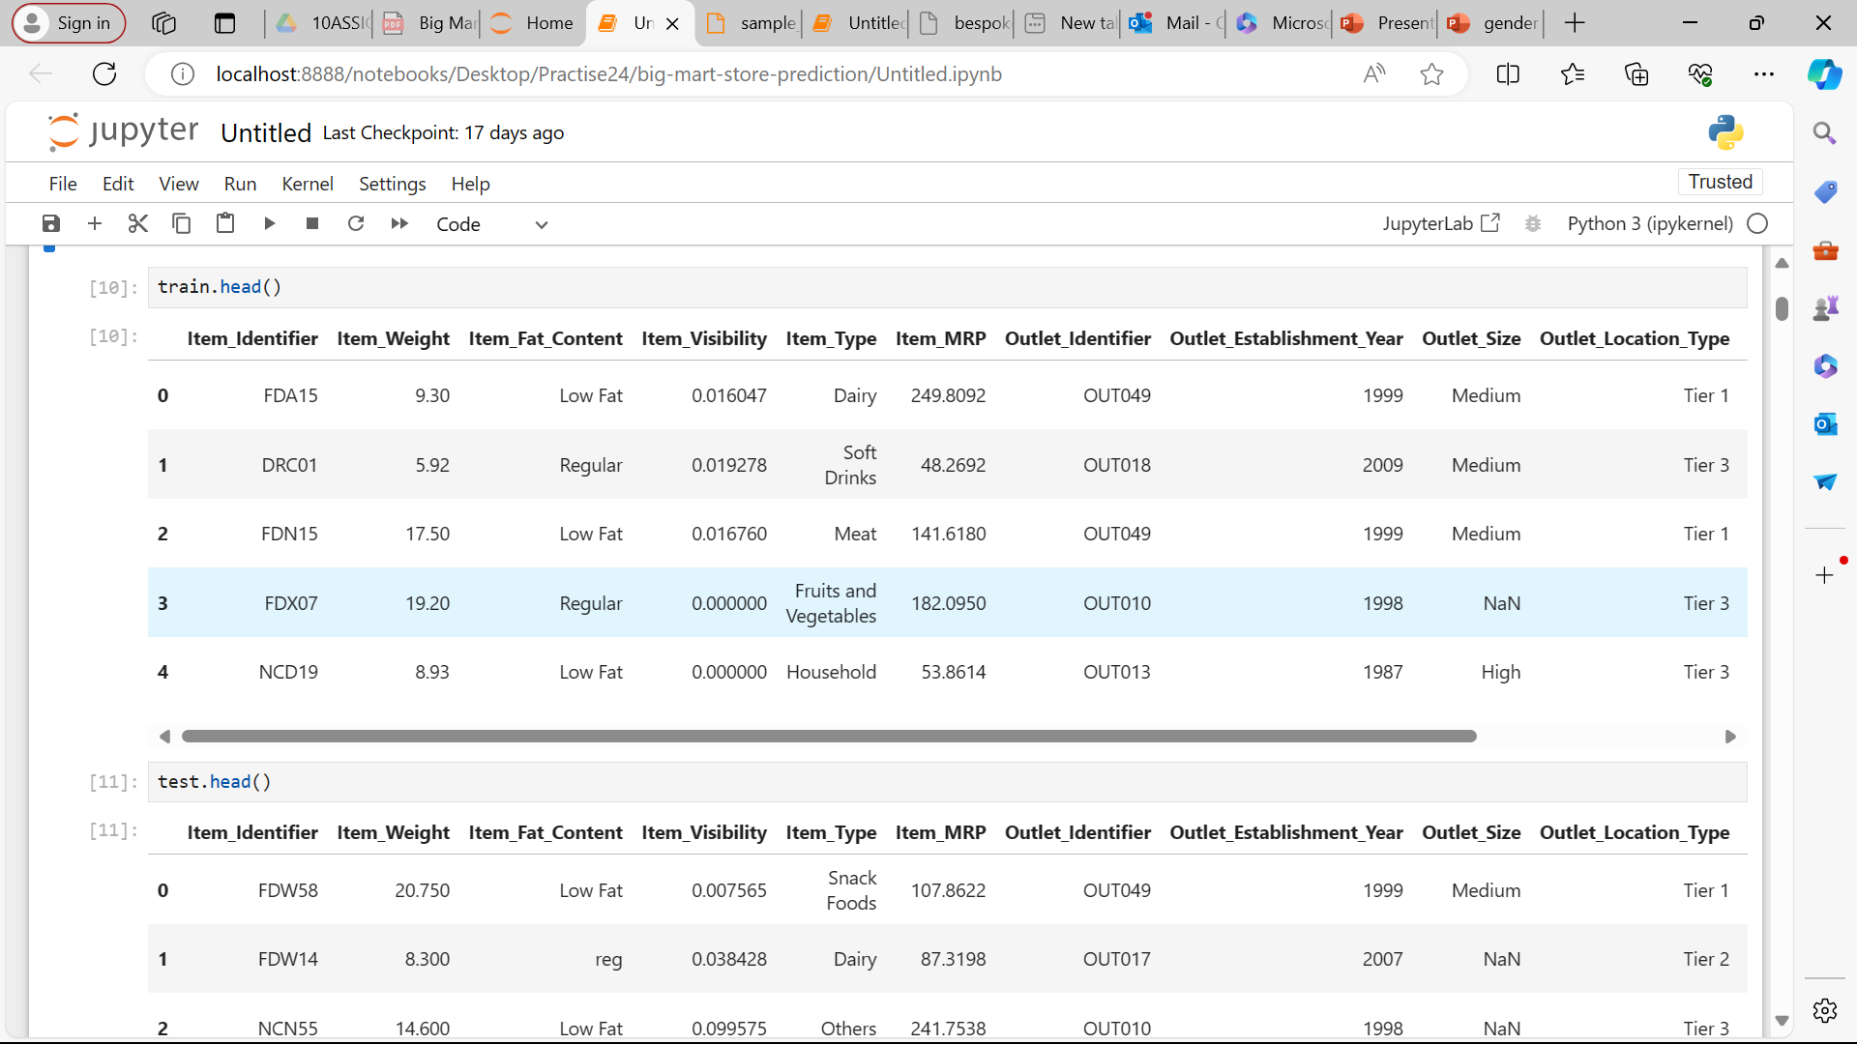
DISPLAYING TRAIN
SHOWING TRAIN DATA THAT I LOADED ON DTAFRAME

Slide 7
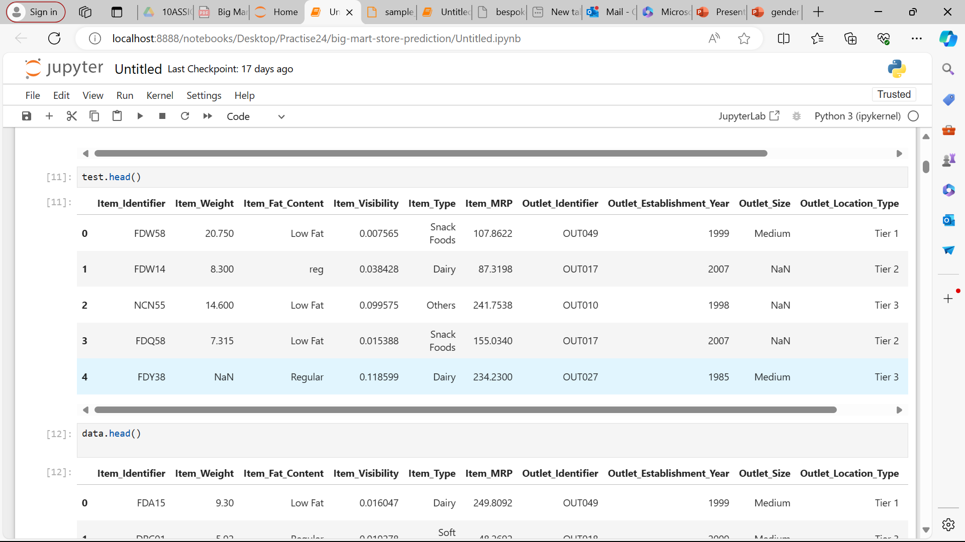
TEST DATA
DISPLAY TEST DATA ON DATAFRAME CALlED TEST

Slide 8
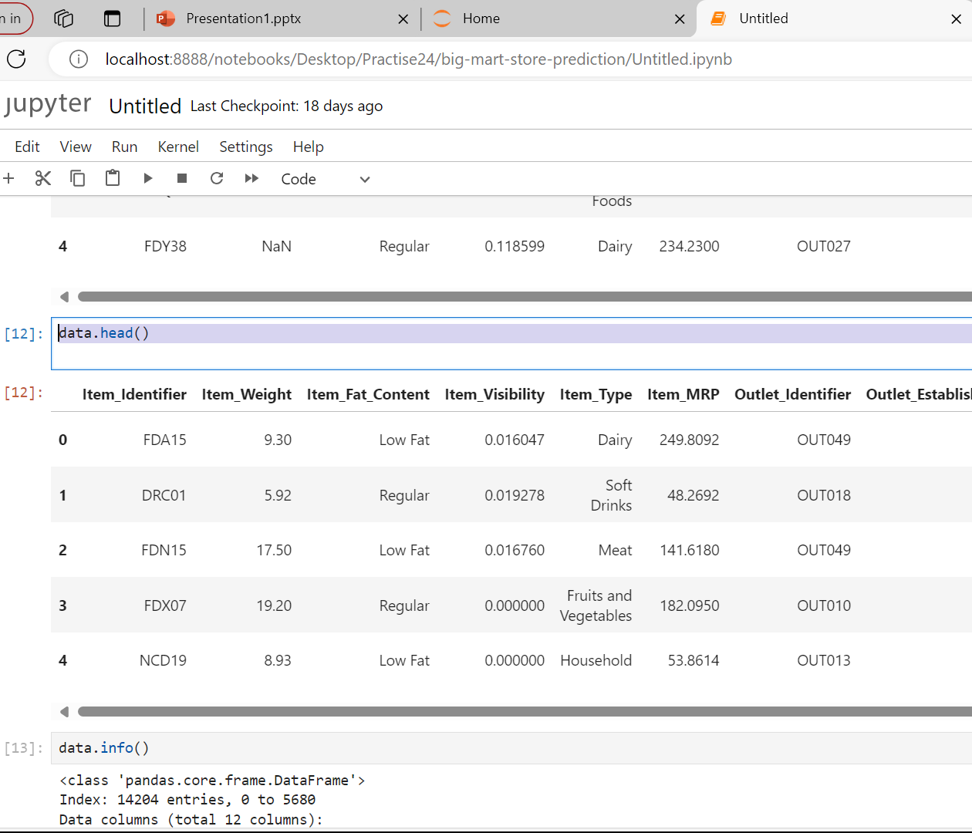
Dispay data
We display the data we loaded on one datafrema DATA

Slide 9
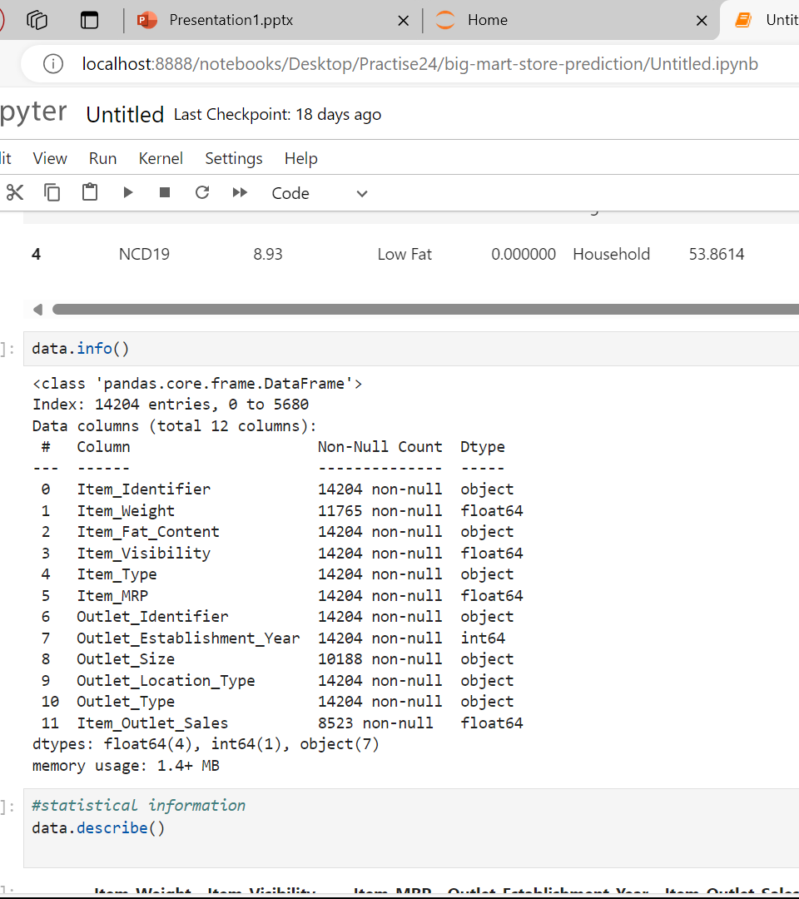
print a concise summary of a DataFrame
The class and memory address of the DataFrame.
The number of non-null entries and total entries in each column.
The data type of each column.
The memory usage of the DataFrame.
checking for missing values and understanding the data types of each column.

Slide 10
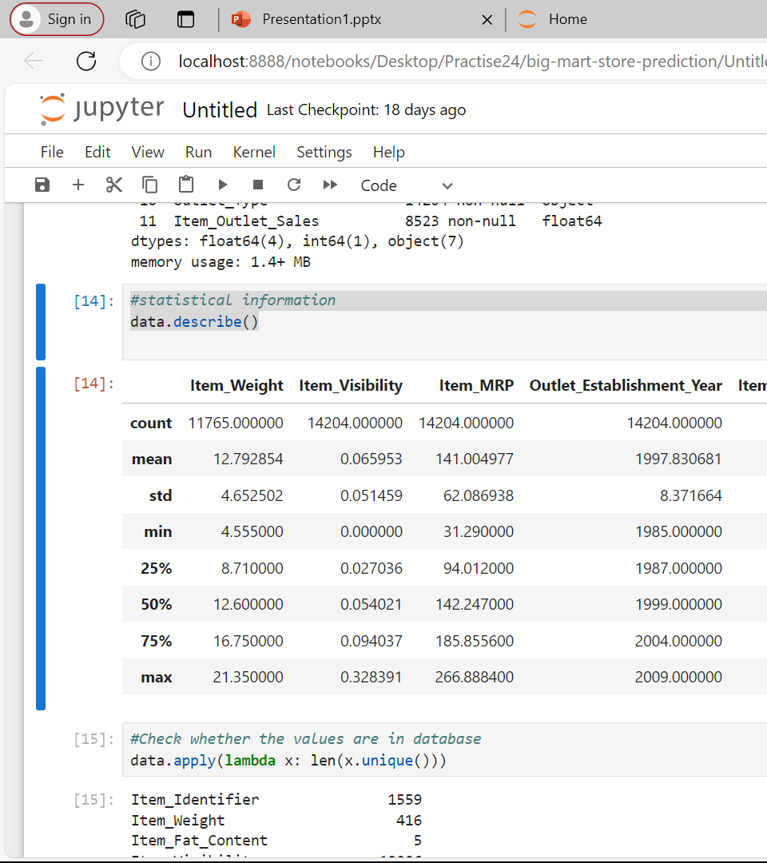
statistical information
is a powerful tool for quickly obtaining a summary of the central tendency, dispersion and shape of the distribution of a dataset’s numerical values
It is a useful step in exploratory data analysis, providing insights into the characteristics of your data.

Slide 11
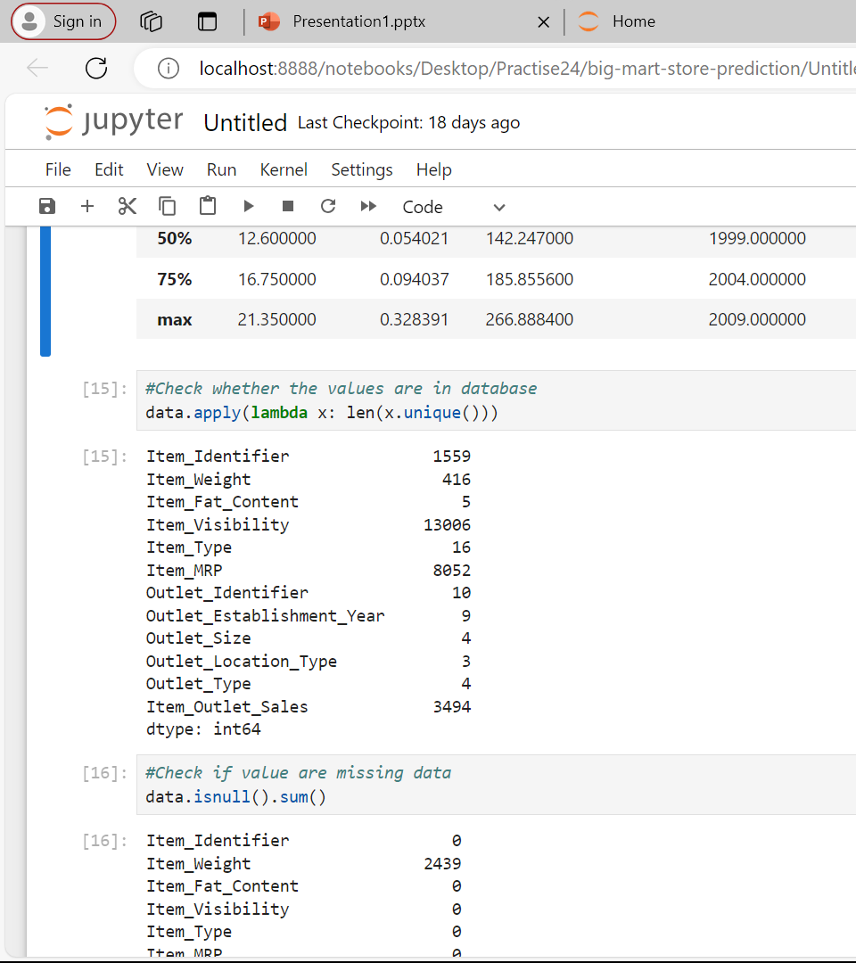
Check values in database
is used to apply a function to each column of a DataFrame and return the number of unique values in each column.
data.apply(): The apply method is used to apply a function along an axis of the DataFrame.
lambda x: len(x.unique()): This lambda function takes a column (x), computes the number of unique values in the column using x.unique(), and returns the length of this array.

Slide 12
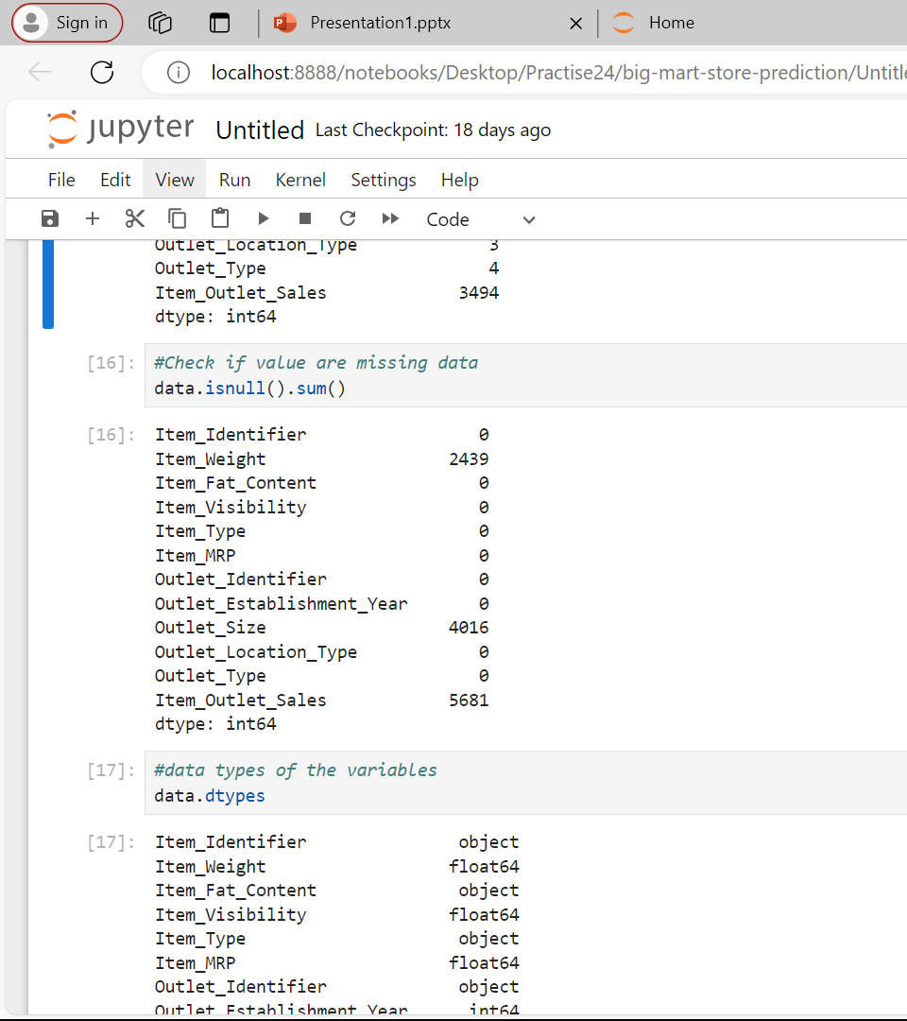
Check if value are missing data
data.isnull(): This method returns a DataFrame of the same shape as data with boolean values indicating whether each element is NaN (null) or not.
sum(): This method, when applied to the boolean DataFrame, sums up True values (which are equivalent to 1), effectively counting the number of NaN values in each column.

Slide 13
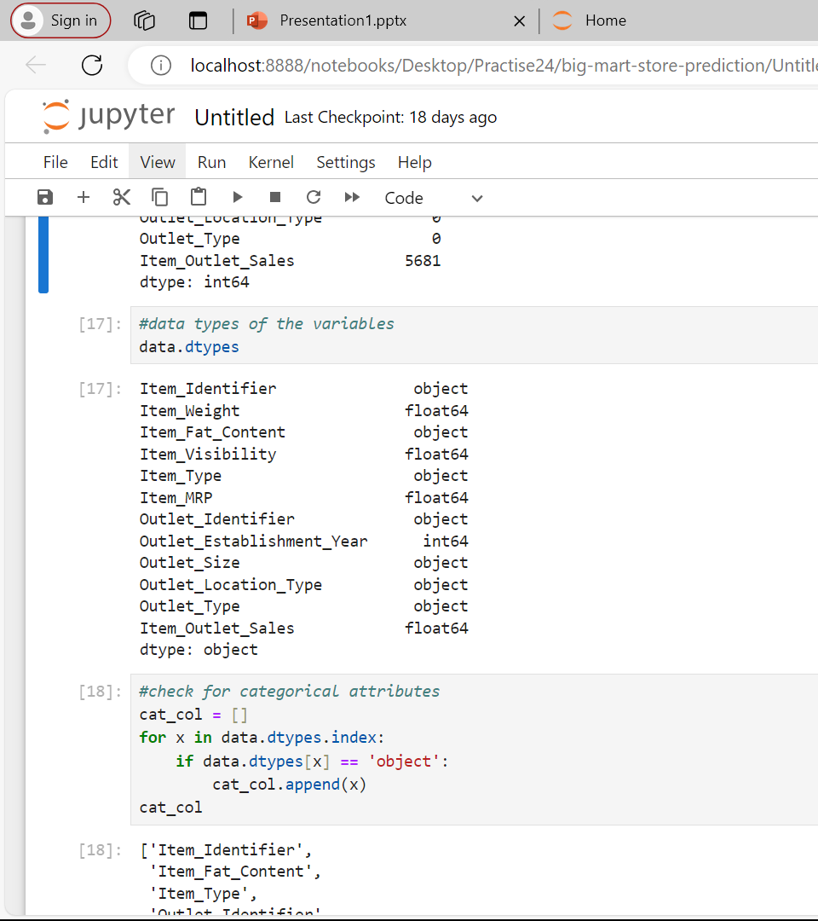
data types of the variables
Checking different types of data type I have

Slide 14
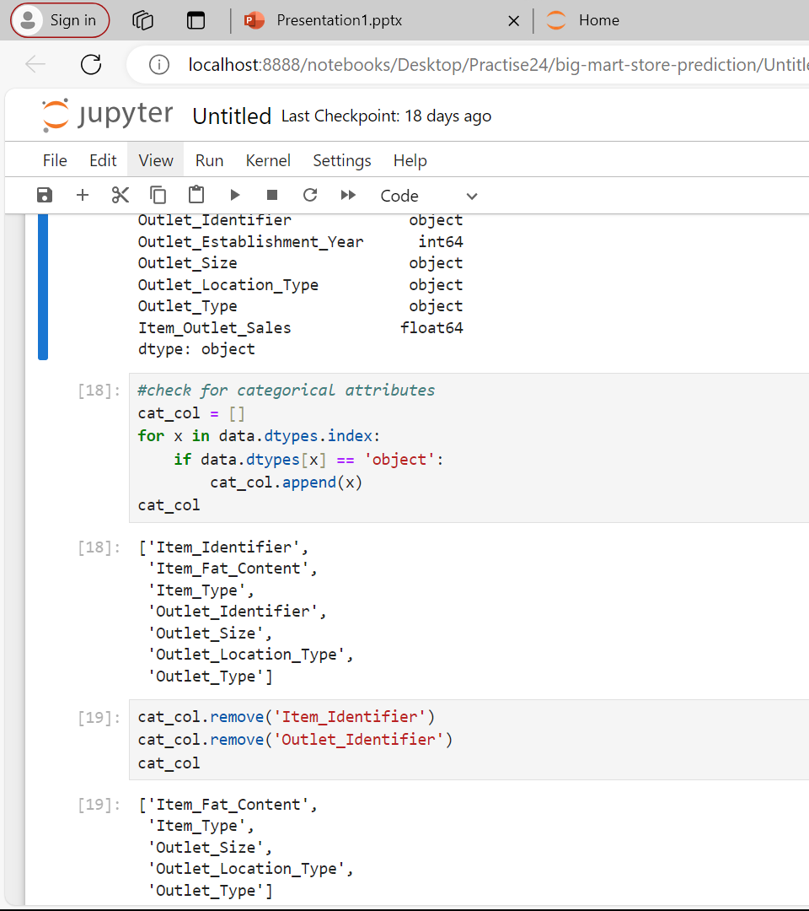
Check for categorical attributes
identifies the categorical columns in a DataFrame data by checking the data type of each column.
Columns with a data type of 'object' are considered categorical and are added to the list cat_col
Cat_col = []: Initializes an empty list to store the names of categorical columns.
for x in data.dtypes.index: Iterates over the column names of the DataFrame data.if data.dtypes[x] == 'object': Checks if the data type of the column is 'object'.cat_col.append(x):
If

Slide 15
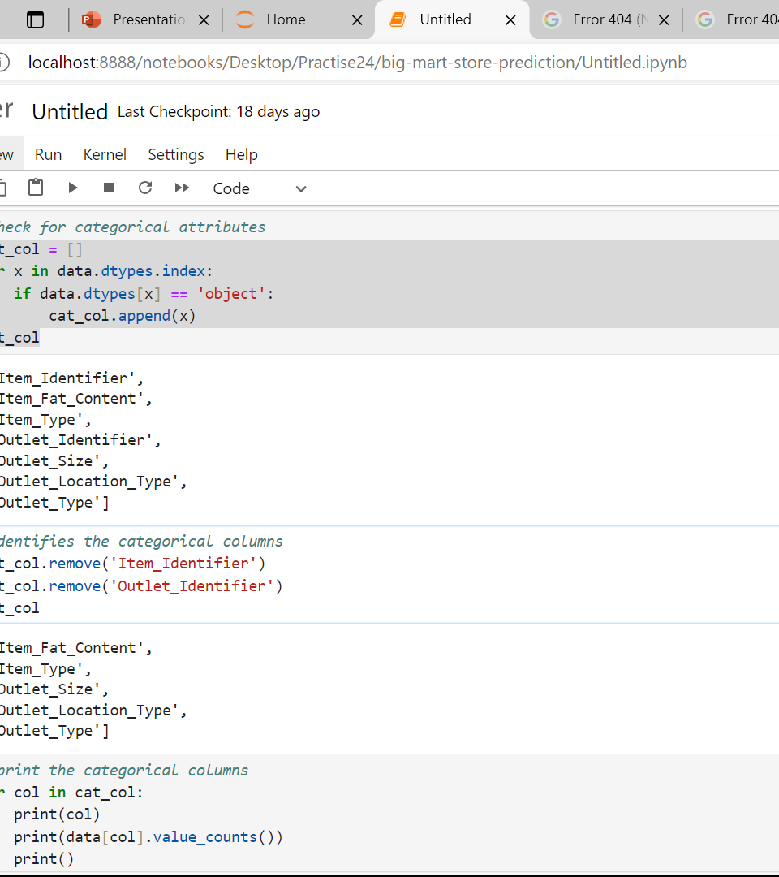
identifies the categorical columns
for x in data.dtypes.index: Iterates over the column names of the DataFrame data.
if data.dtypes[x] == 'object': Checks if the data type of the column is 'object'.
cat_col.append(x): If the column's data type is 'object', its name is appended to the list cat_col.
cat_col: The final list of categorical column names

Slide 16
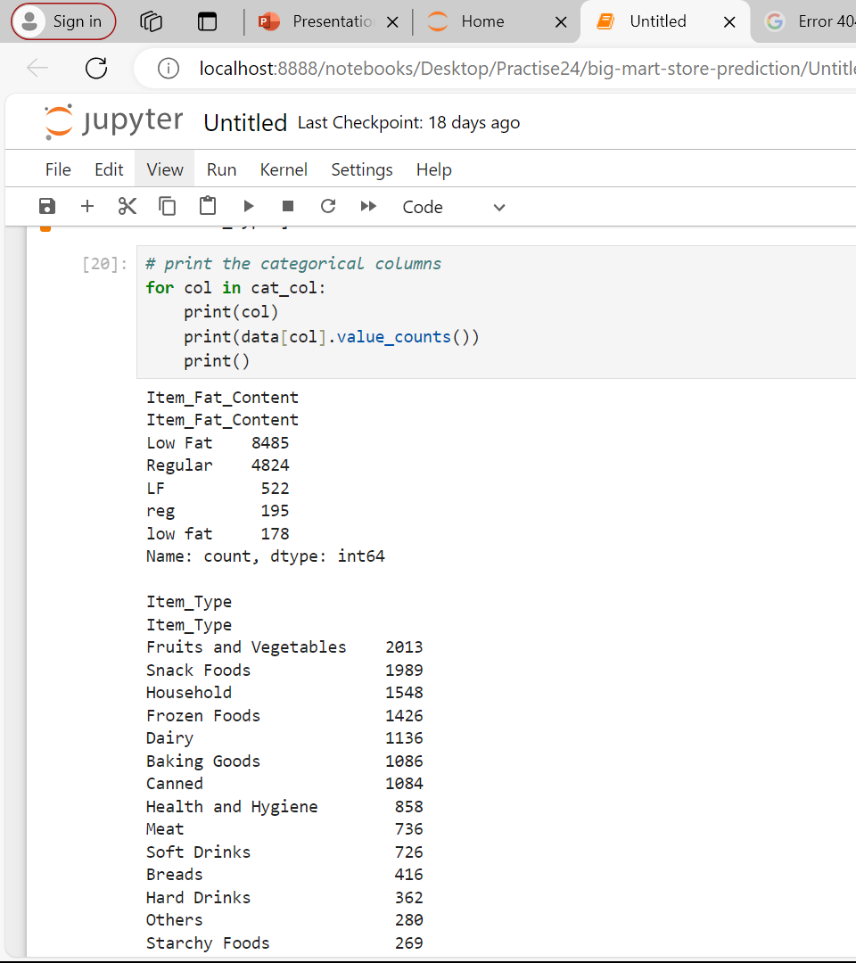
prints the name of the current column
prialue_counts method returns a Series containing counts of unique values.nts Print Newline: print() adds an extra newline for better readability between outputs of different columns.
the value counts of the current column
Print Newline: print() adds an extra newline for better readability between outputs of different columns.

Slide 17
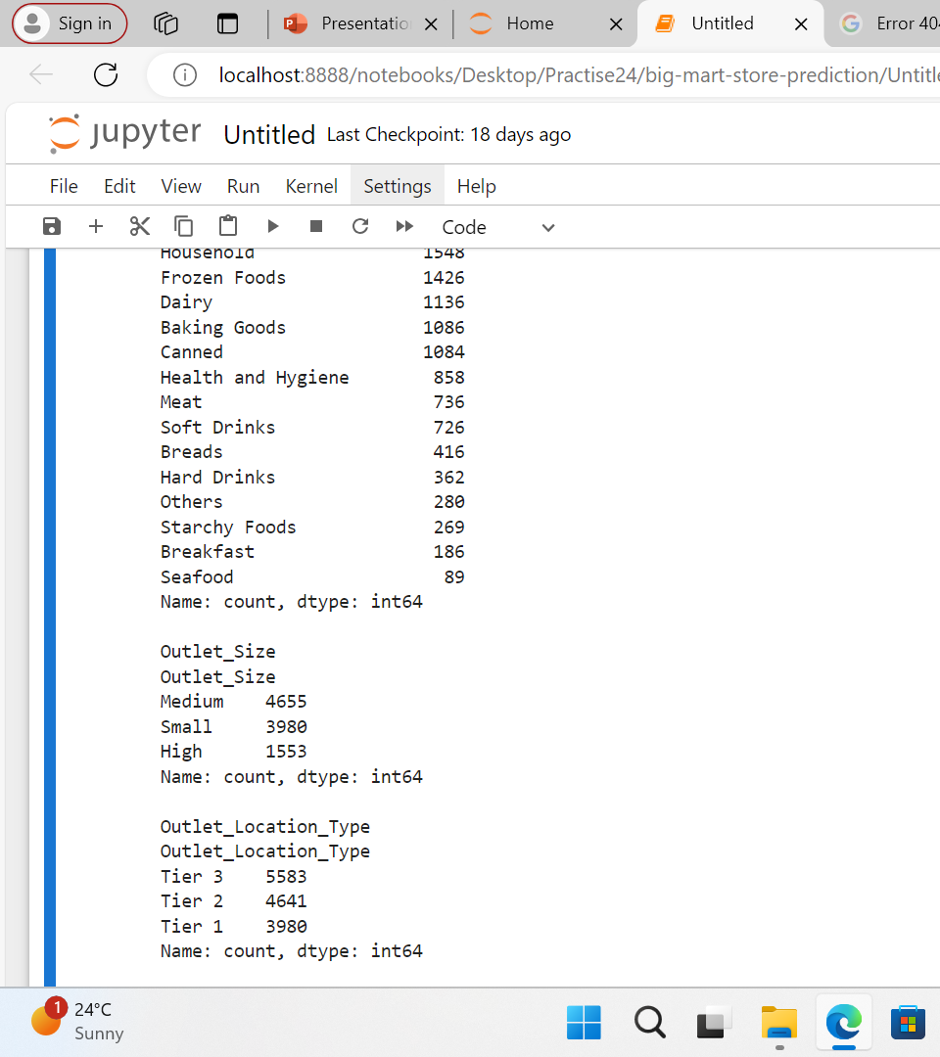
RECAP ON prints the name of the current column

Slide 18
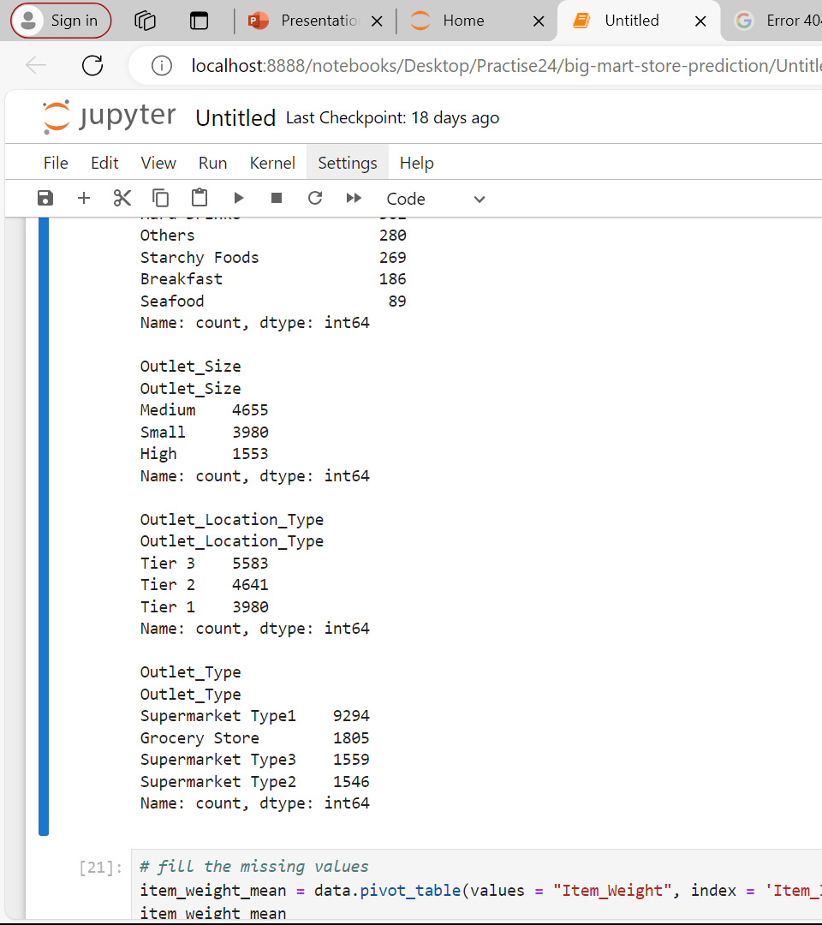
RECAP ON prints the name of the current column

Slide 19
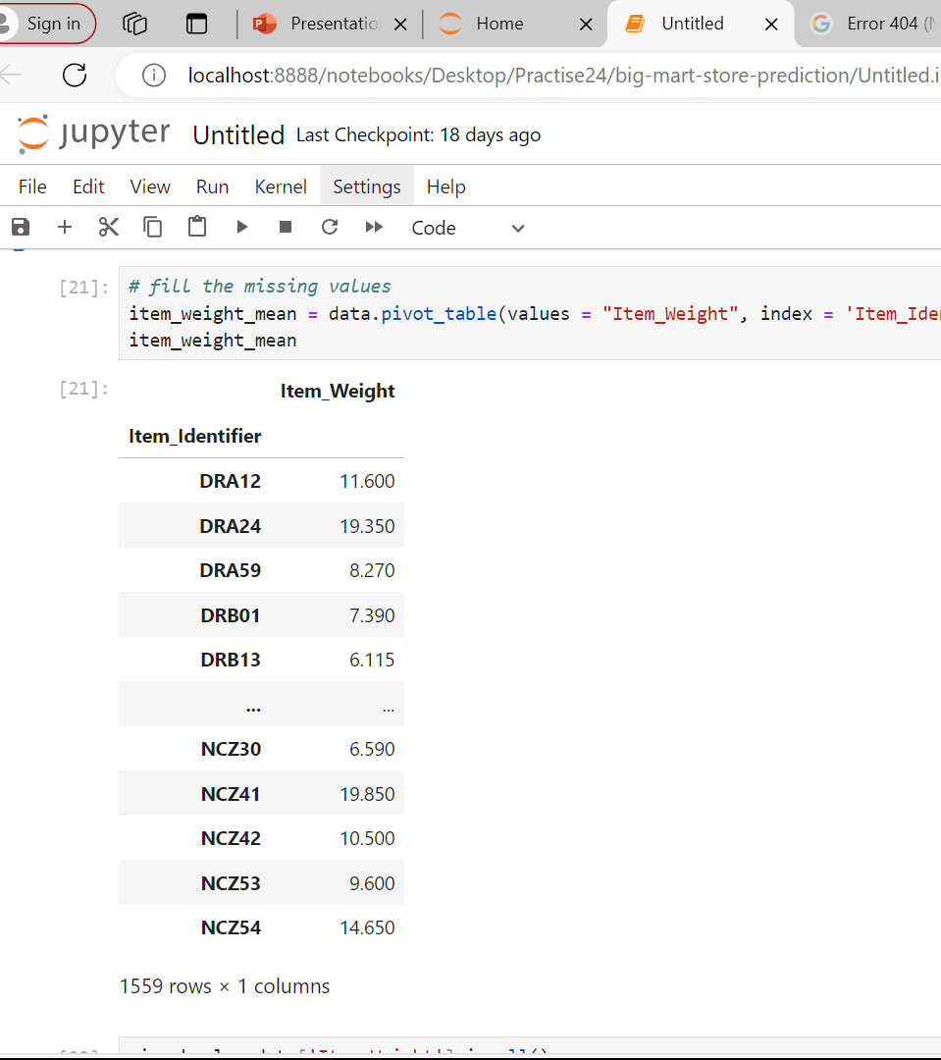
fill the missing values
item_weight_mean = data.pivot_table(values = "Item_Weight", index = 'Item_Identifier')
item_weight_mean
This parameter specifies the column for which we want to calculate the aggregation
This parameter specifies the column to be used as the index for the pivot table. Each unique value in

Slide 20
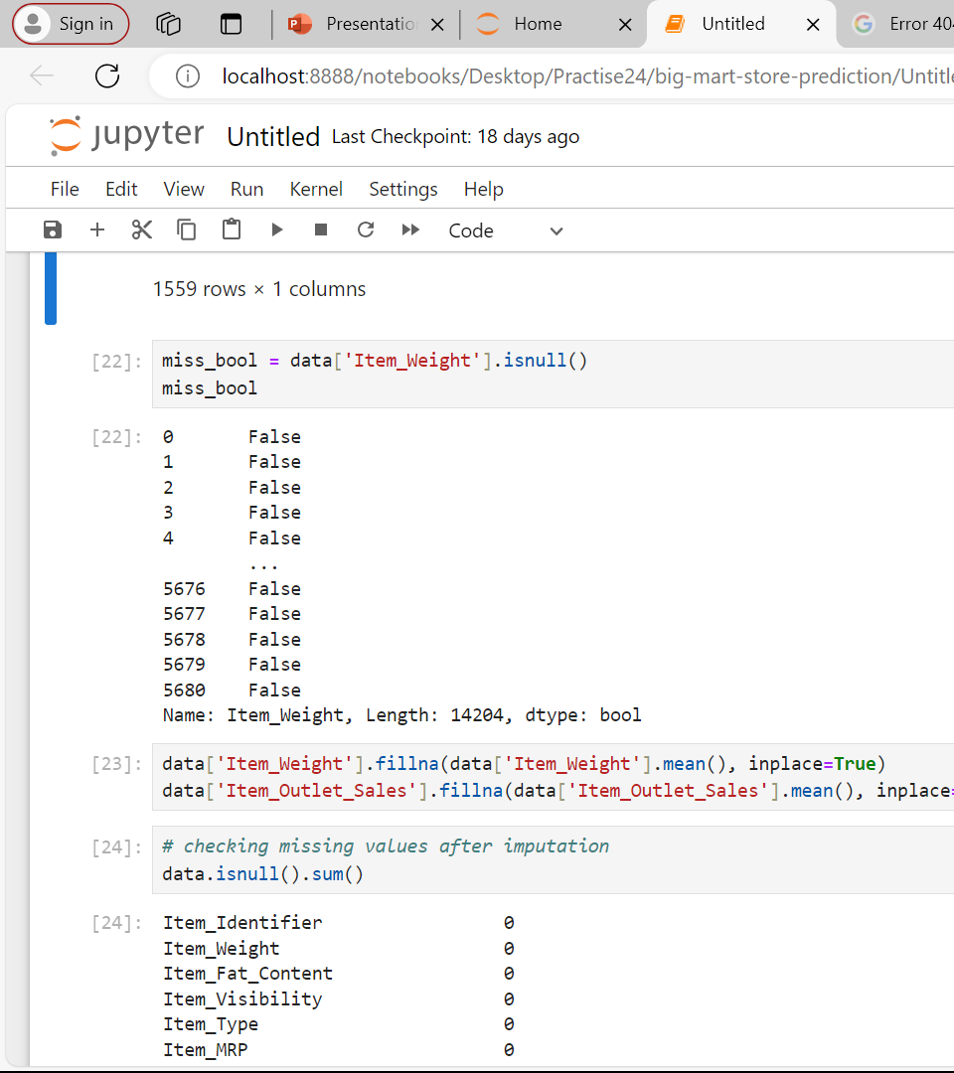
create a boolean Series
is used to create a boolean Series indicating which values in the It: This accesses the Item_Weight column from the DataFrameem_Weight

Slide 21
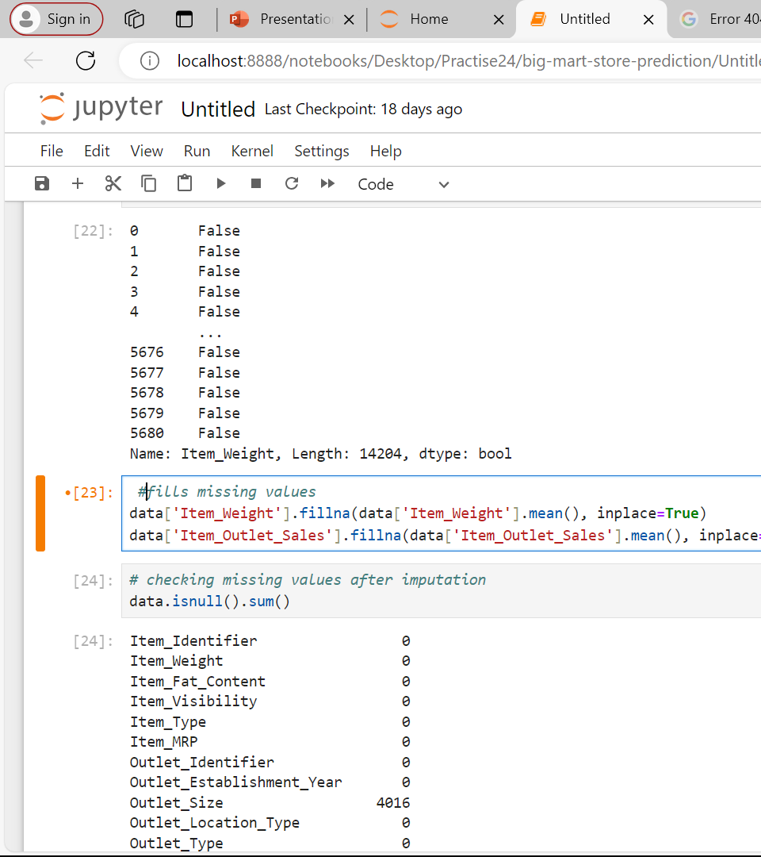
fills missing values
This code will generate a Series showing True for rows where Item_Weight is missing and False otherwise.

Slide 22
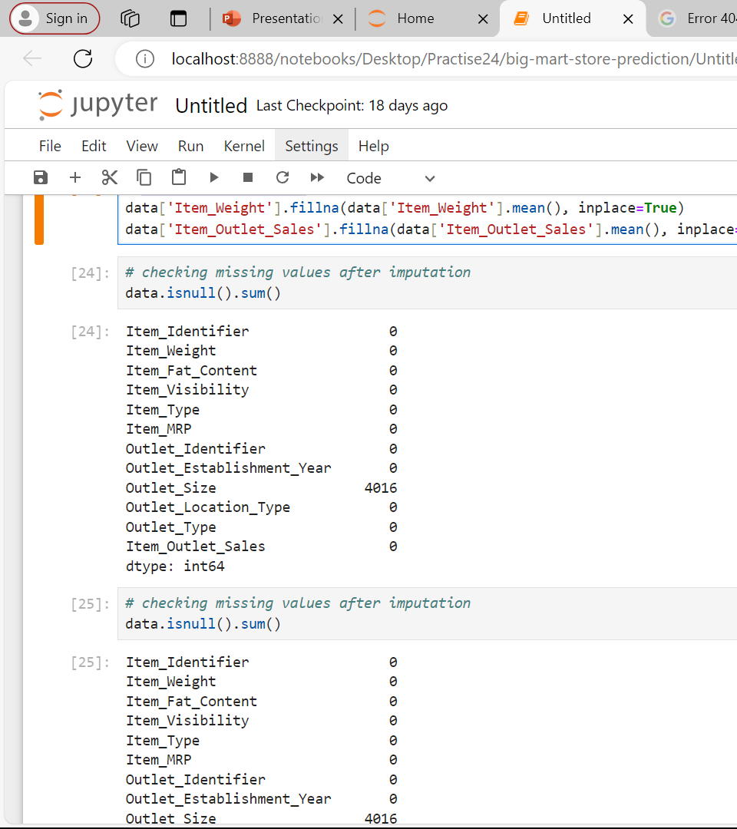
checking missing values after imputation
To check for any remaining missing values in the DataFrame data after filling the missing values in the Item_Weight and Item_Outlet_Sales columns, you can use the isnull() method combined with the sum() method. This will provide a count of missing values for each column.

Slide 23
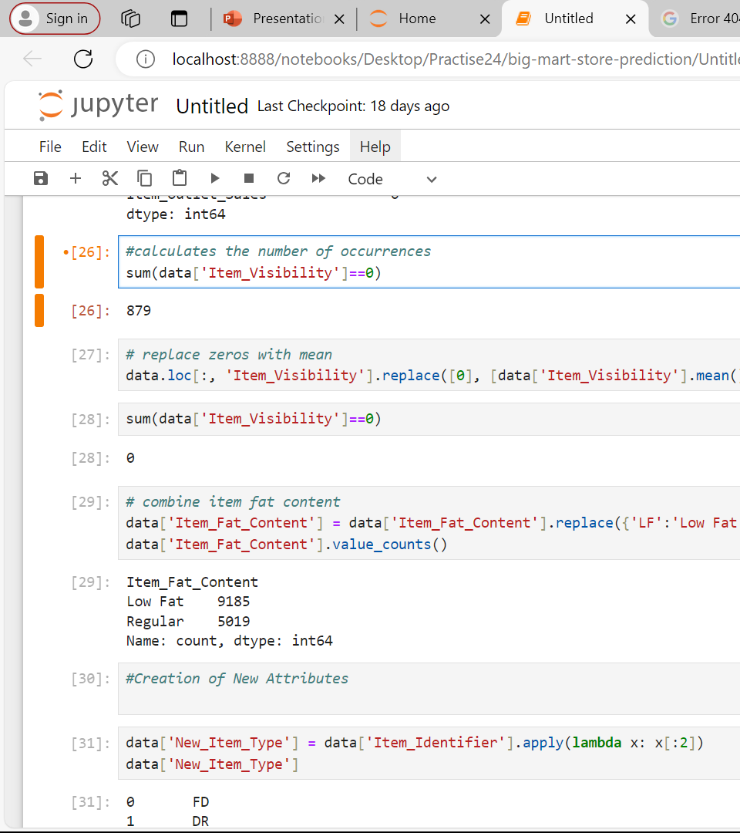
calculates the number of occurrences
The line of code sum(data['Item_Visibility'] == 0) calculates the number of occurrences where the Item_Visibility column in the DataFrame data has a value of 0.

Slide 24
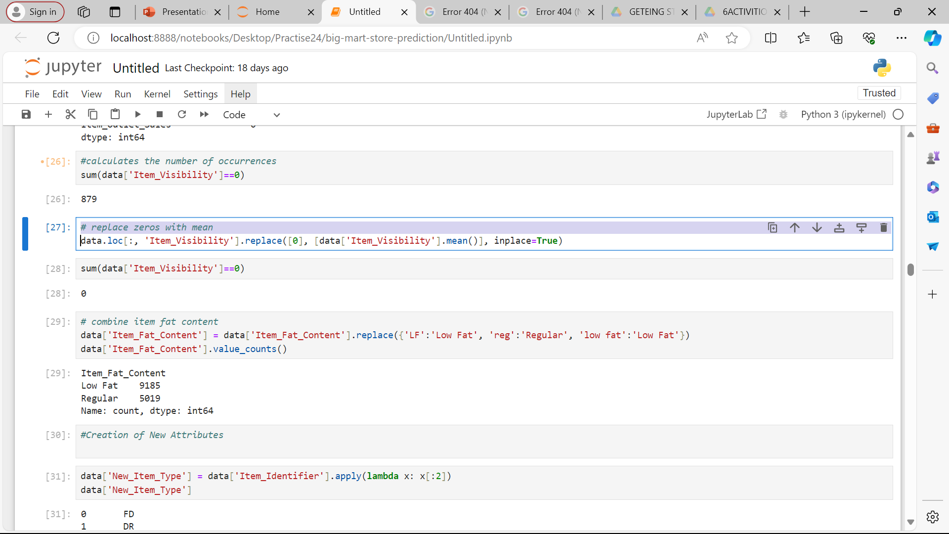
replace zeros with mean
is used to replace all occurrences of 0 in the

Slide 25
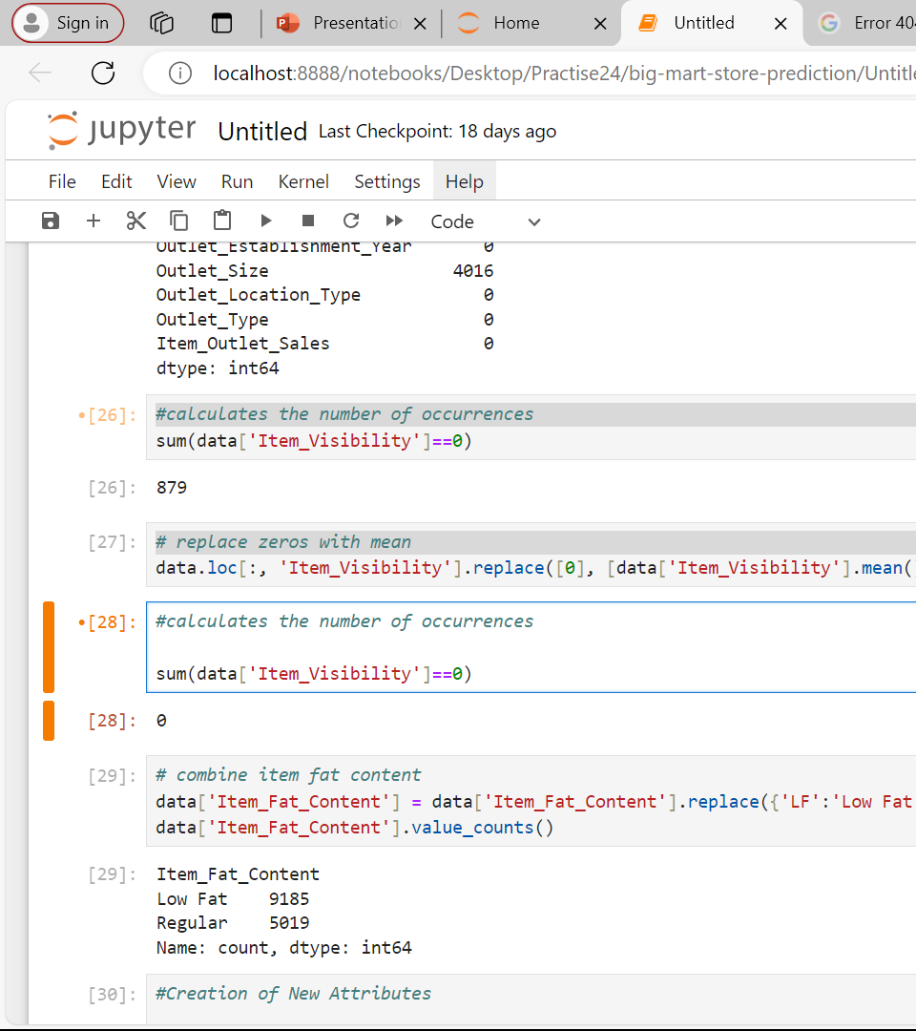
calculates the number of occurrences
This will ensure that any zero values in the Item_Visibility column are replaced with the mean of the non-zero Item_Visibility values in your dataset.
This code will return the number of occurrences where the Item_Visibility is still 0

Slide 26
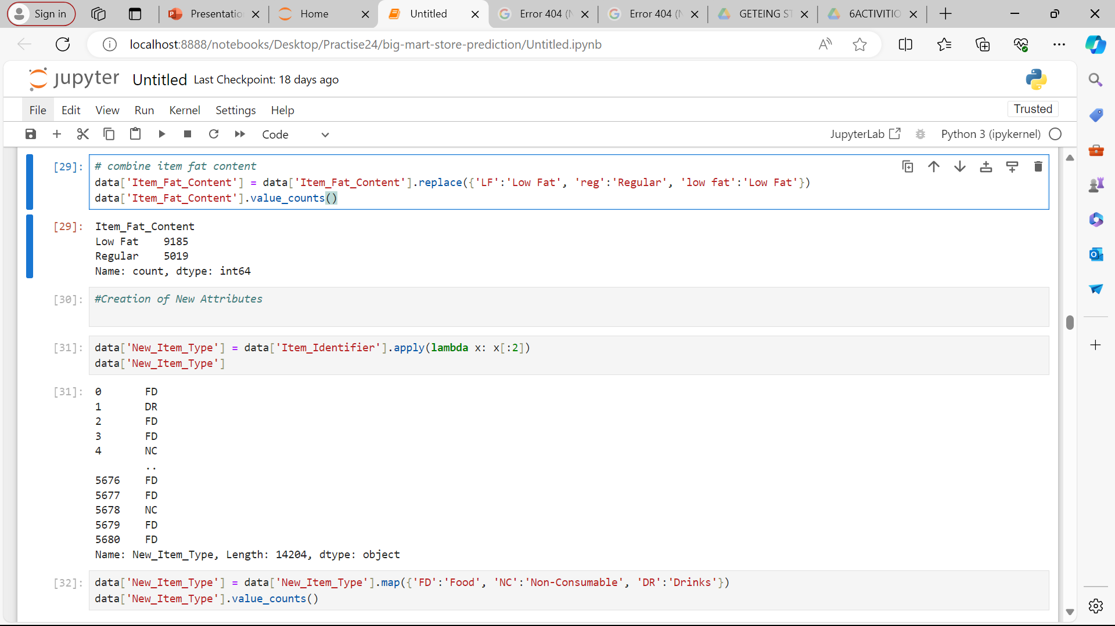
# combine item fat content
The code data['Item_Fat_Content'] = data['Item_Fat_Content'].replace({'LF':'Low Fat', 'reg':'Regular', 'low fat':'Low Fat'}) is used to standardize the values in the Item_Fat_Content column of the DataFrame data. It replaces 'LF' and 'low fat' with 'Low Fat', and 'reg' with 'Regular'. After this replacement, the code data['Item_Fat_Content'].value_counts() counts the occurrences of each unique value in the Item_Fat_Content column.

Slide 27
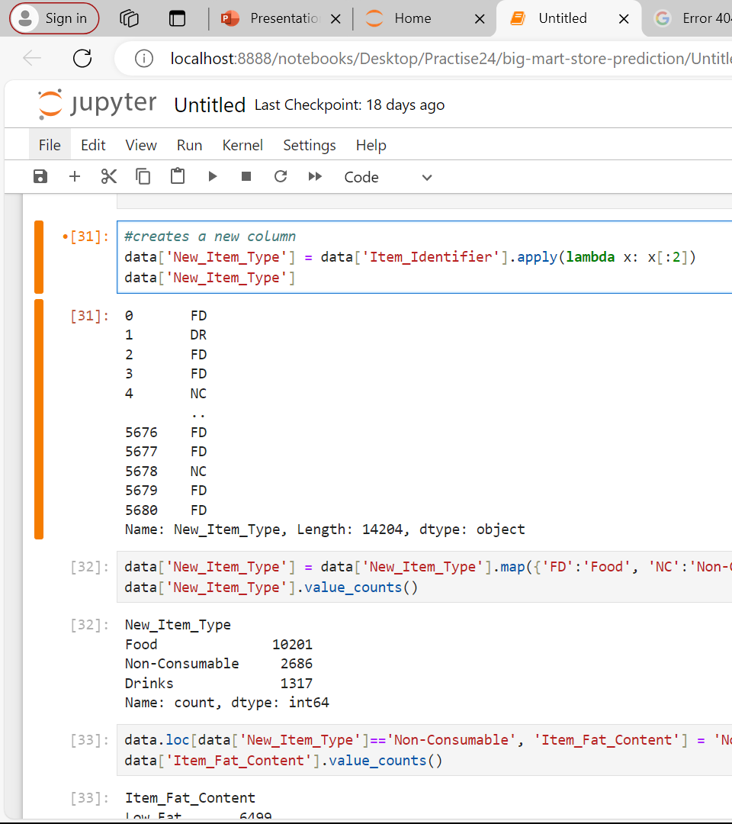
creates a new column

Slide 28
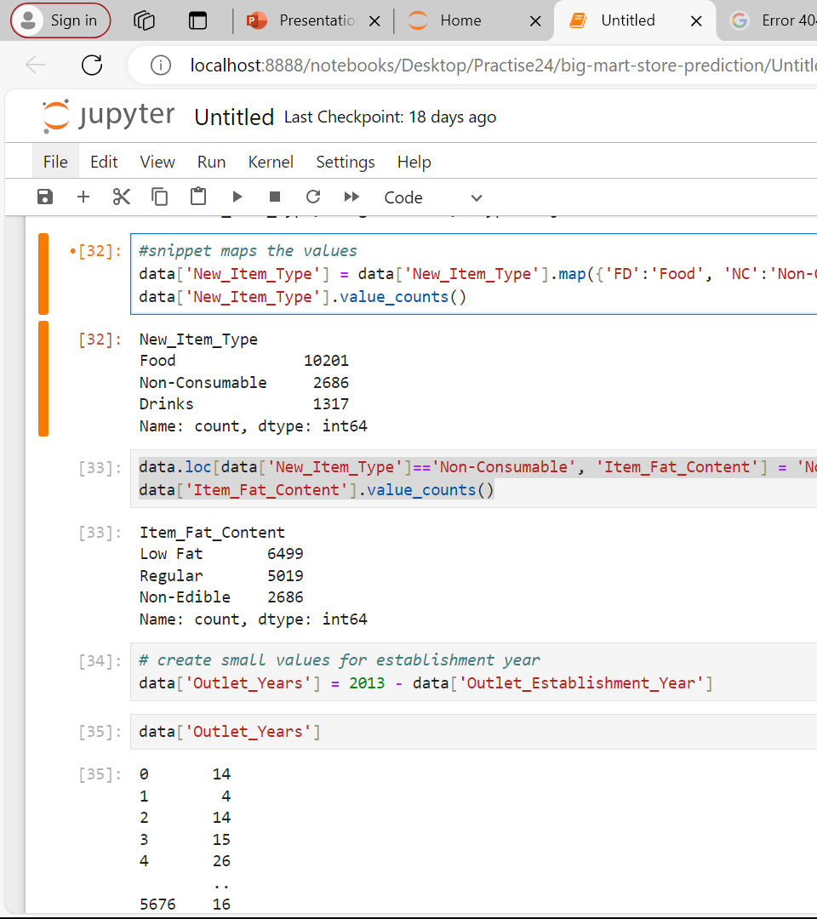
snippet maps the values
maps the values in the New_Item_Type column to more descriptive names. After mapping,counts the occurrences of each unique value in the New_Item_Type column.
Explanation

Slide 29
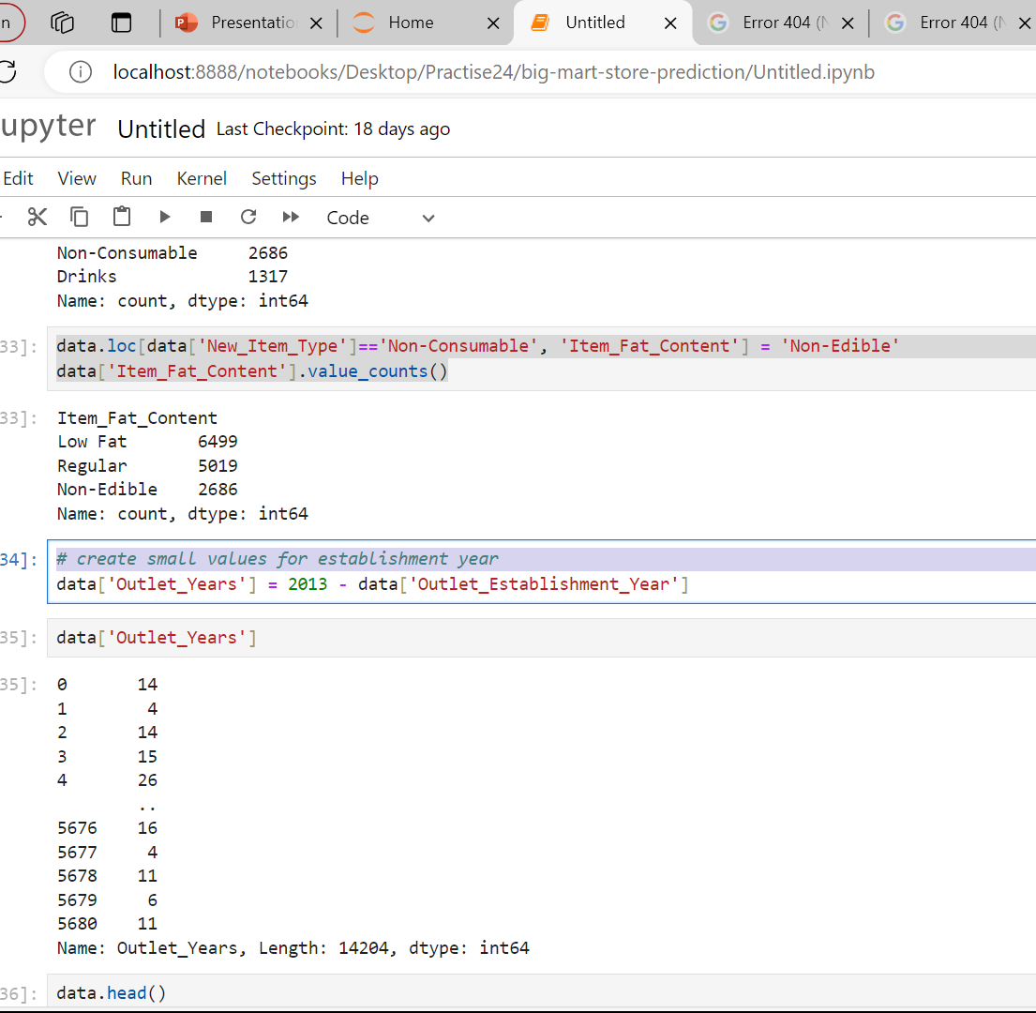
# create small values for establishment year
This will calculate the age of each outlet in years and add a new column Outlet_Years

Slide 30
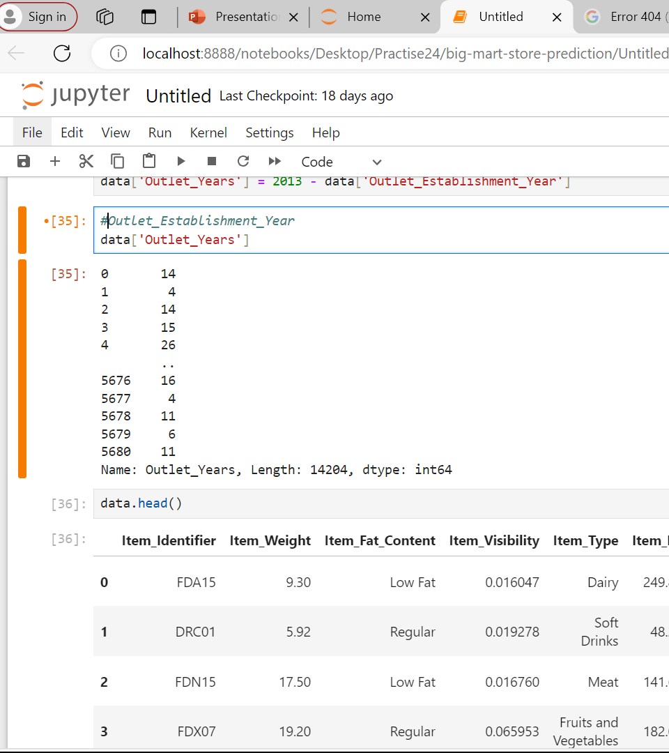
Outlet Establishment Year

Slide 31
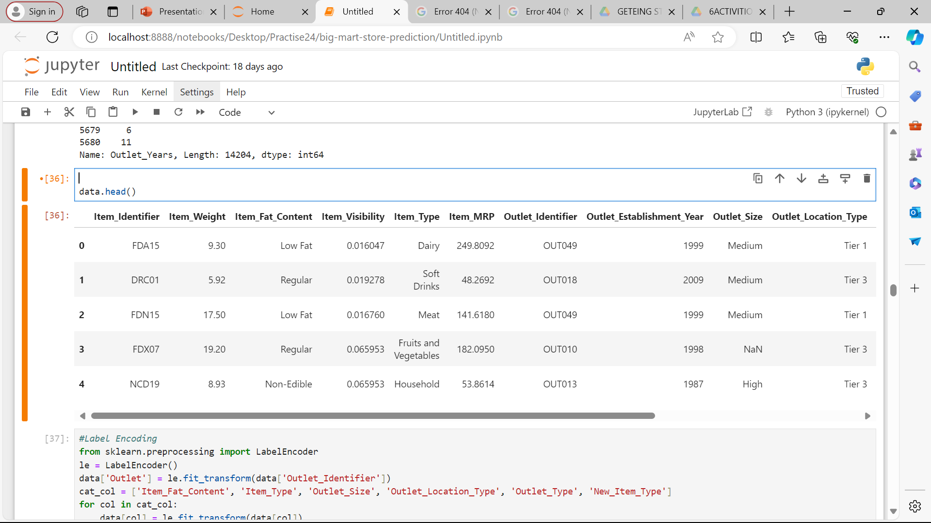
PRINT DATA

Slide 32
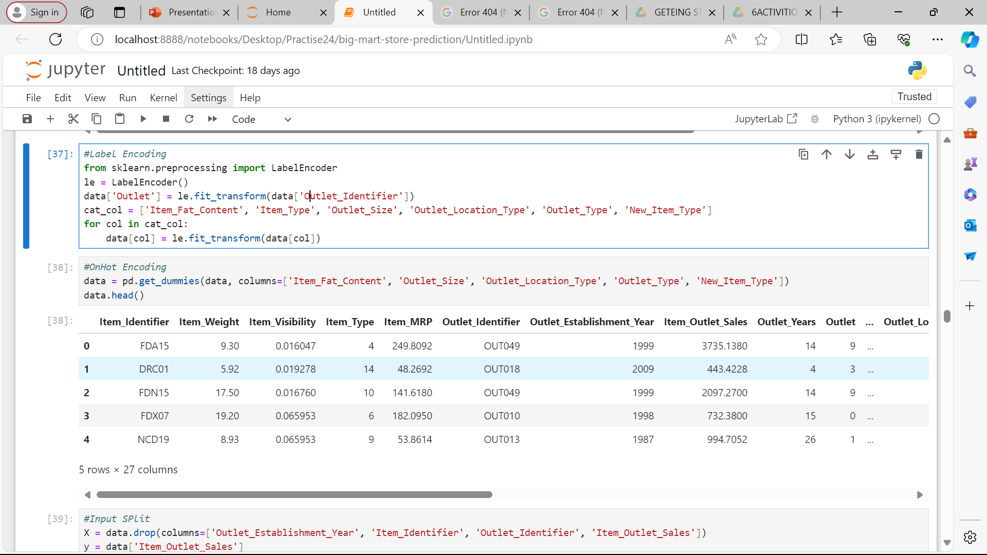
LABEL ENCODING
Label encoding is suitable for categorical variables with a natural ordering, such as ordinal variables.
It transforms each category into a number, which may introduce unintended ordinal relationships. If the categorical variables do not have a natural ordering, consider using one-hot encoding instead to avoid this issue

Slide 33
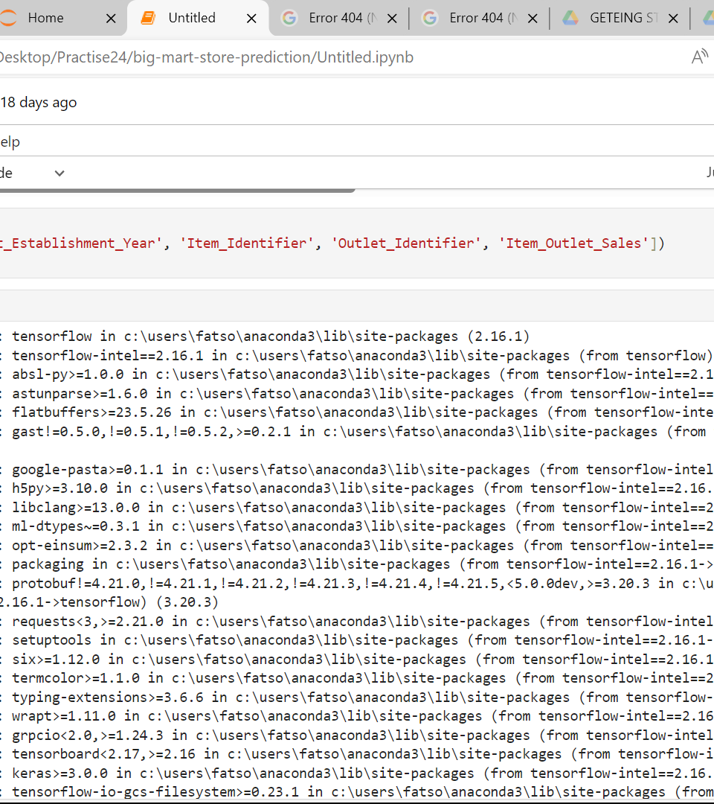
INPUT SPLIT

Slide 34
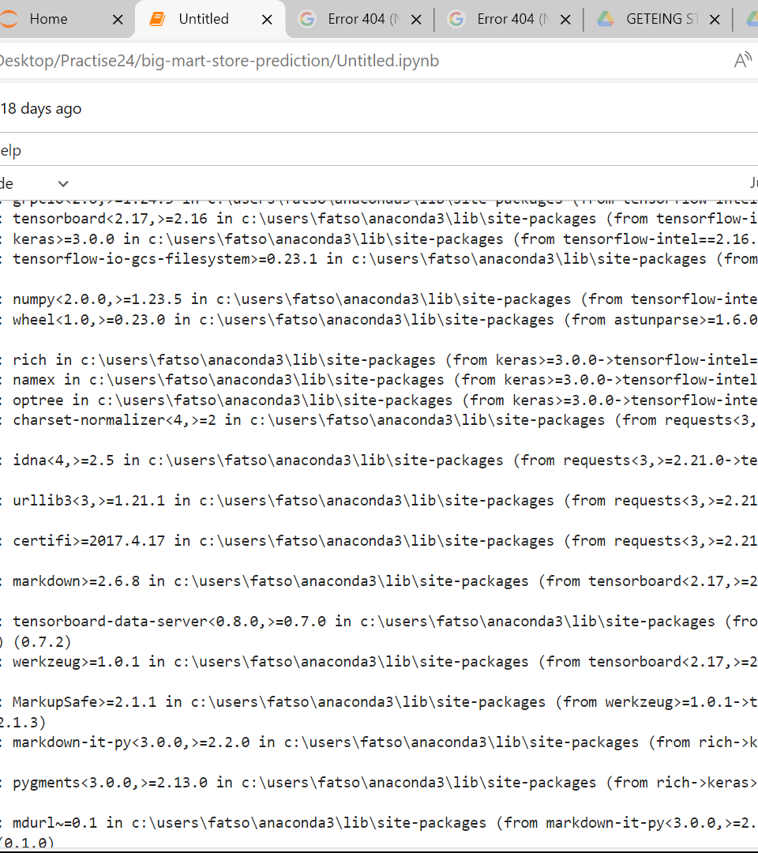
RECAP INPUT SPLIT
the provided code snippet to create X and y for your actual dataset. This approach separates the features from the target variable, making it suitable for machine learning model training and evaluation.

Slide 35
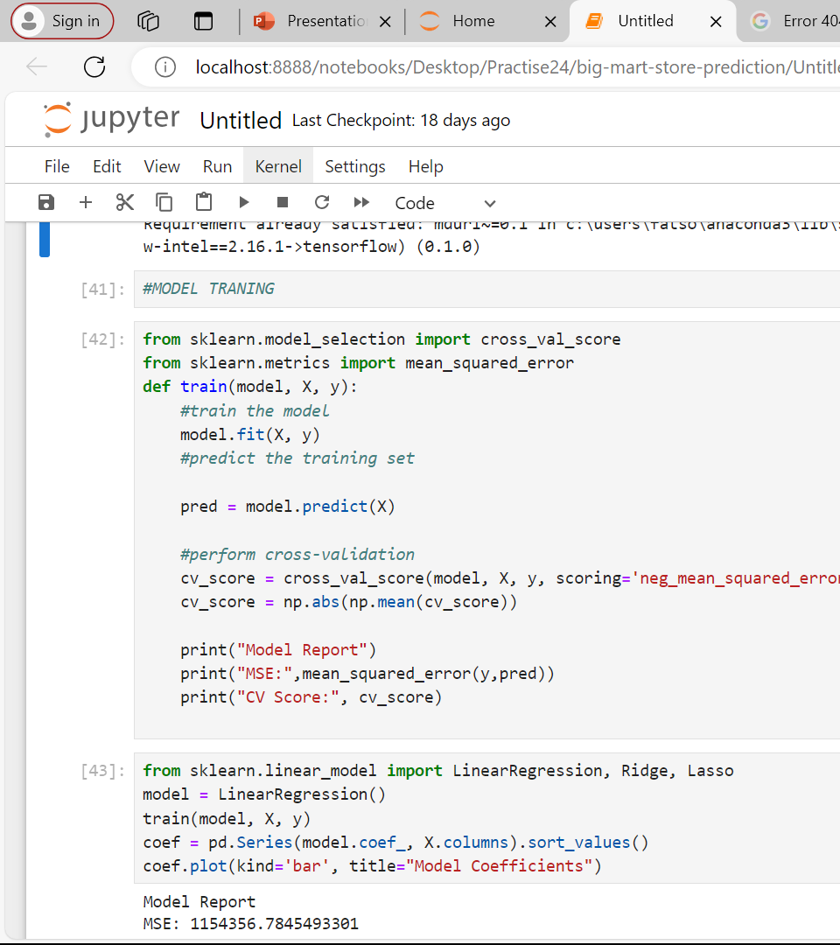
TRIANING MODEL
This function will fit the model on the entire dataset (X), which may not be ideal for model evaluation. Consider splitting the data into training and testing sets to avoid overfitting.

Slide 36
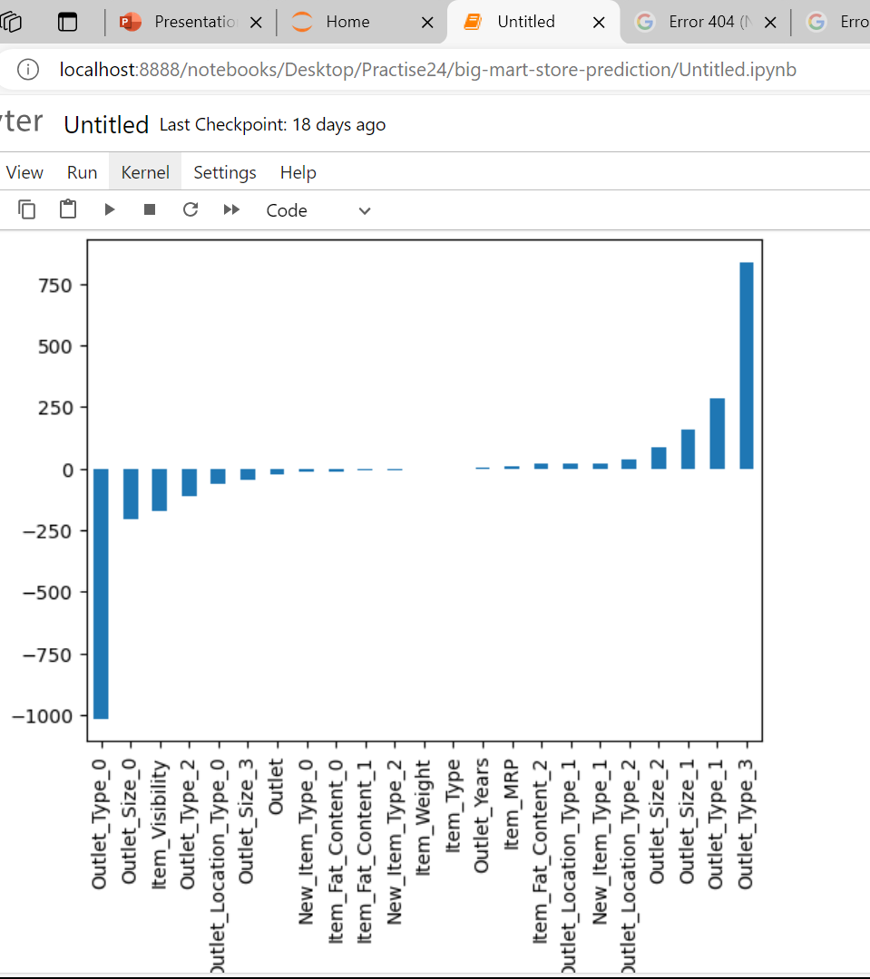
MODEL COEFFICIENT
Ensure that X and y are properly defined and compatible with the model before calling the train function

Slide 37
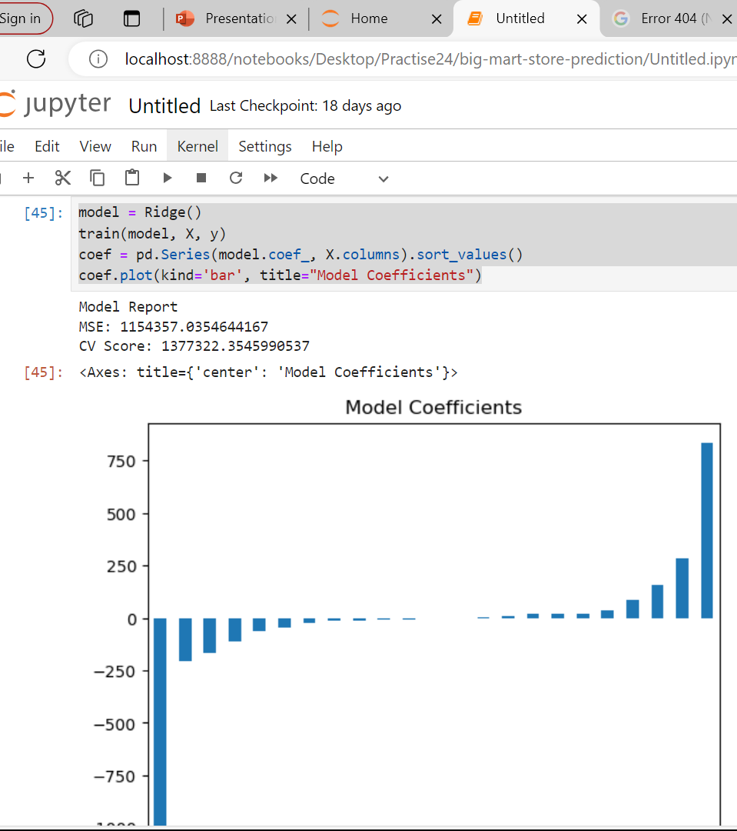

Slide 38
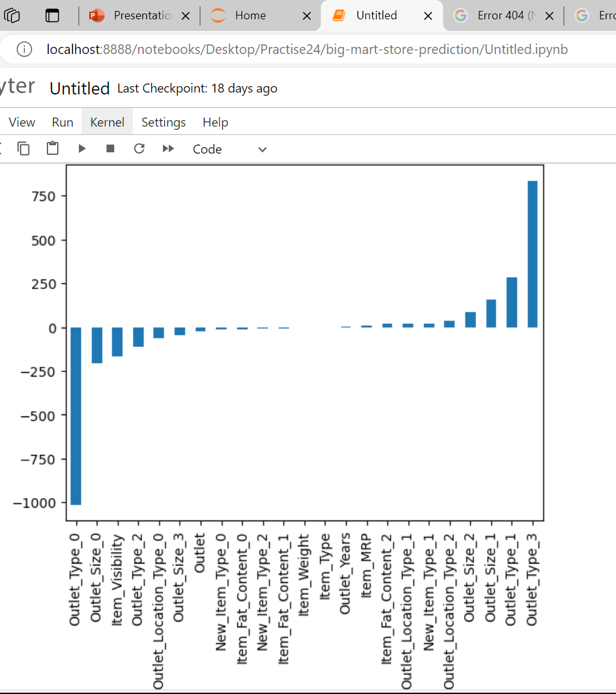

Slide 39
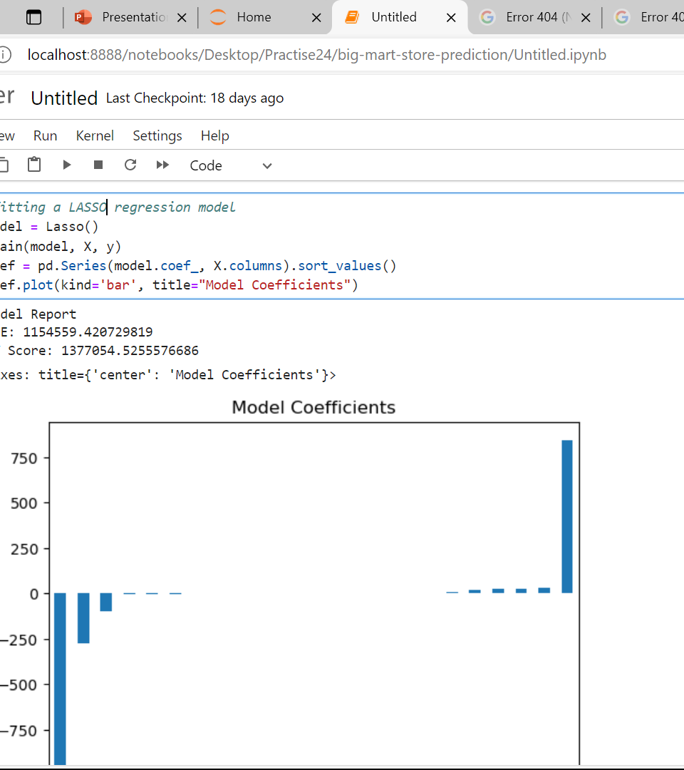
fitting a LASSO regression model
This will train the Lasso regression model on the provided data (X and y), print model reports (MSE and CV Score), and plot the coefficients of the features as a bar plot.

Slide 40
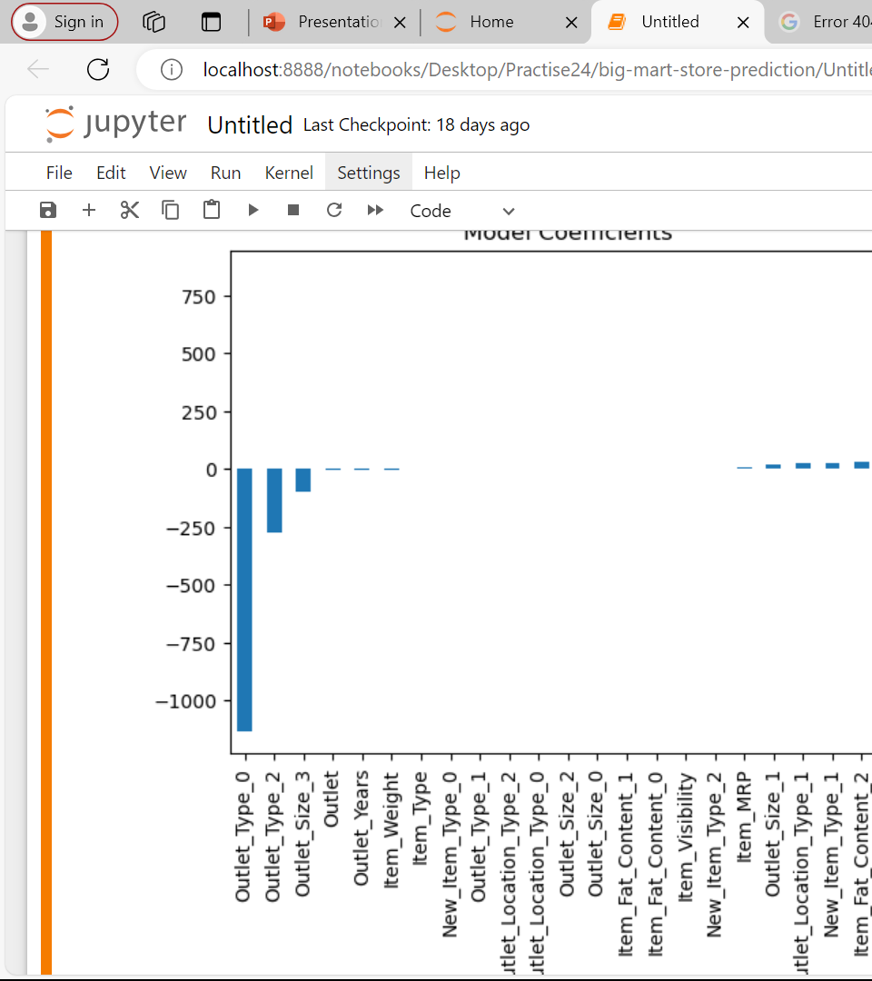
COEFFICIENT MODE

Slide 41
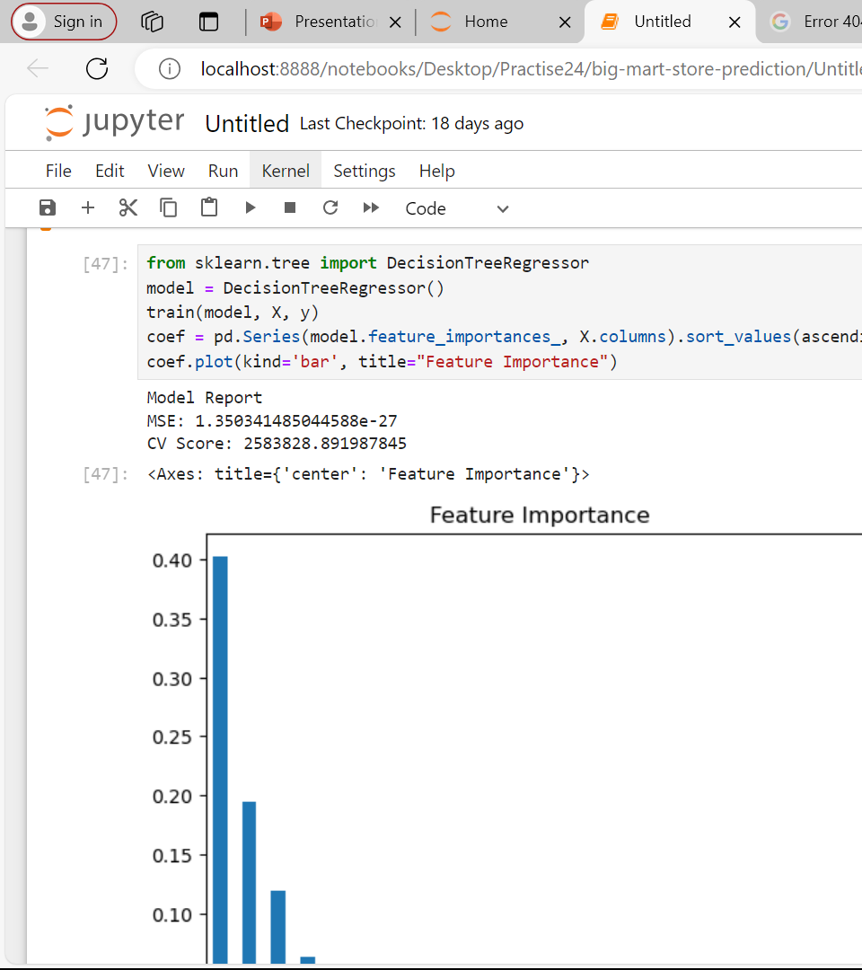
VISUALIZING IMPORTANT FEATURE
This will train the Extra Trees Regressor model on the provided data (X and y), print model reports (MSE and CV Score), and plot the feature importances as a bar plot.

Slide 42
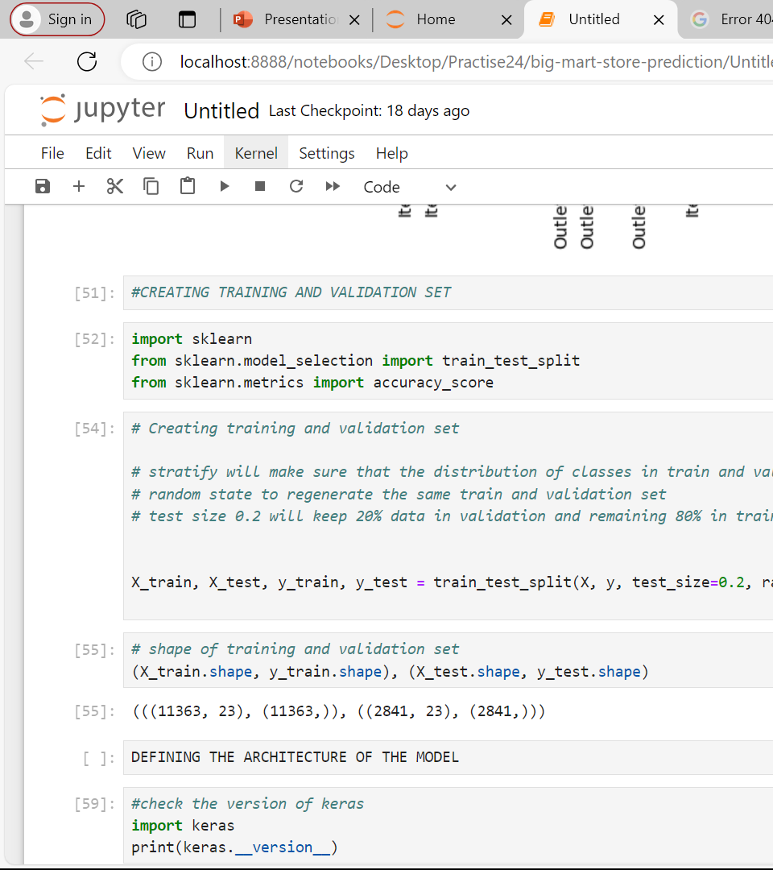
REATING TRAINING AND VALIDATION SET
This will split your dataset (X and y) into training and testing sets, with 80% of the data used for training and 20% used for testing. The random seed is set to 42 for reproducibility.

Slide 43
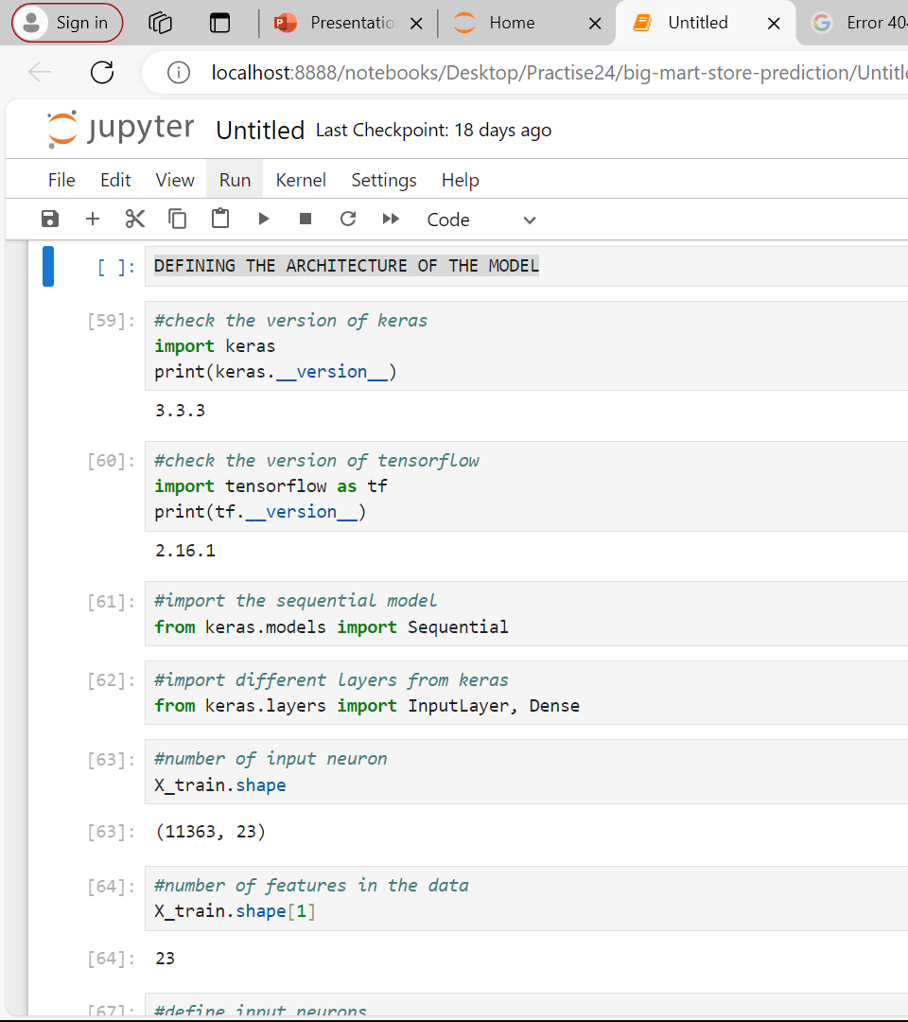
DEFINING THE ARCHITECTURE OF THE MODEL
This will print a summary of the model architecture, showing the number of parameters in each layer and the total nuThe model consists of an input layer with 23 features, followed by three hidden layers with 500, 100, and 50 neurons, respectively, all using ReLU activation functions. Finally, there is an output layer with a single neuron for regression purposesmber of parameters in the model

Slide 44
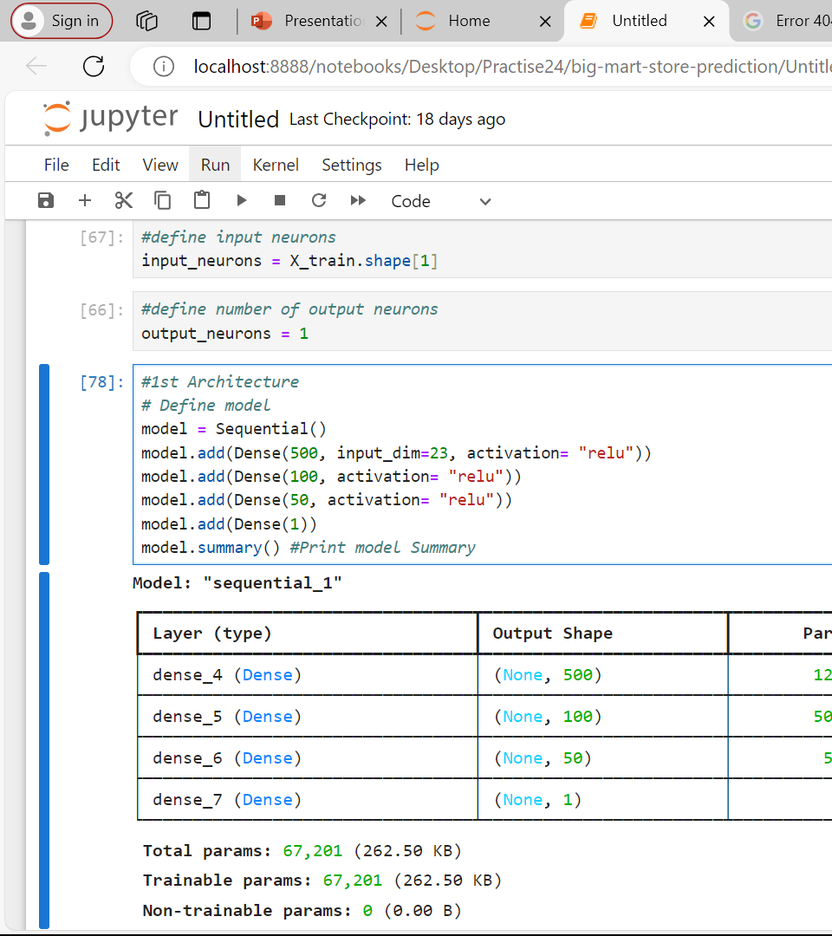

Slide 45
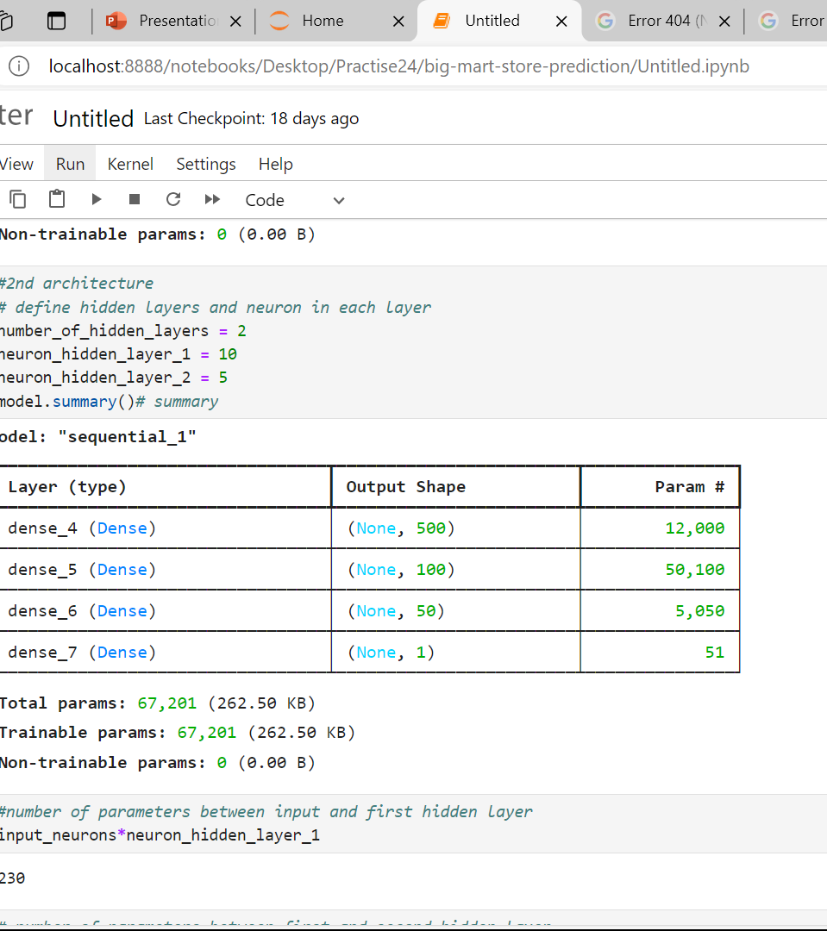

Slide 46
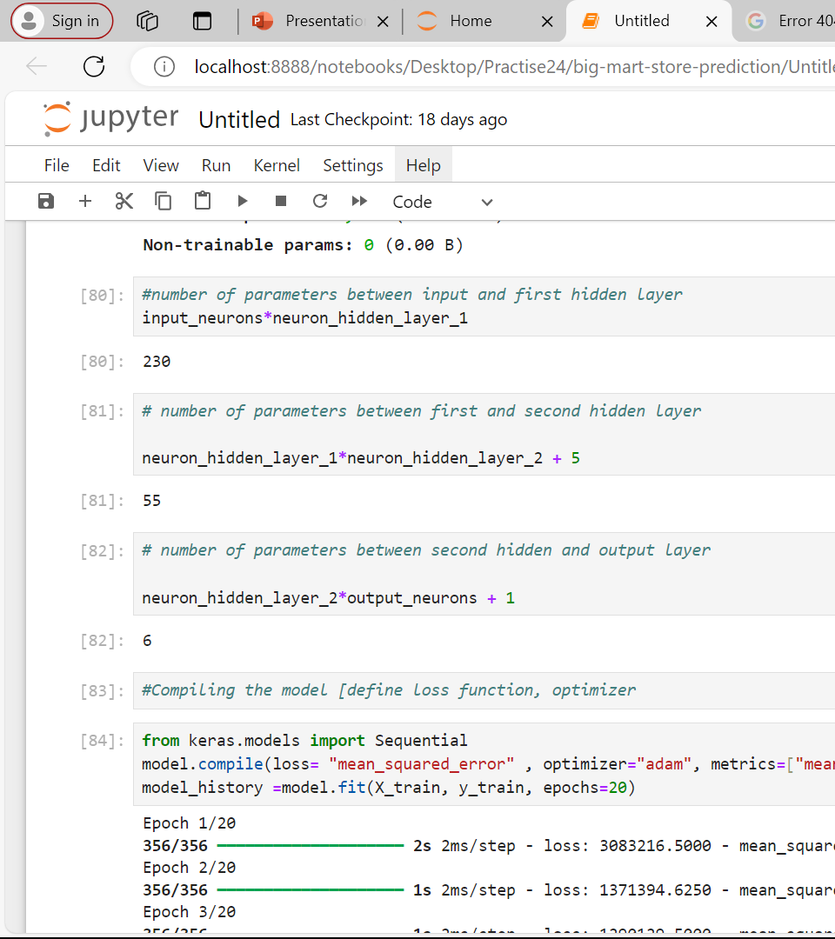
#Compiling the model [define loss function, optimizer
This code will compile and train the neural network model on the provided training data (X_train and y_train) for 20 epochs using the mean squared error loss function, Adam optimizer, and mean squared error metric.

Slide 47
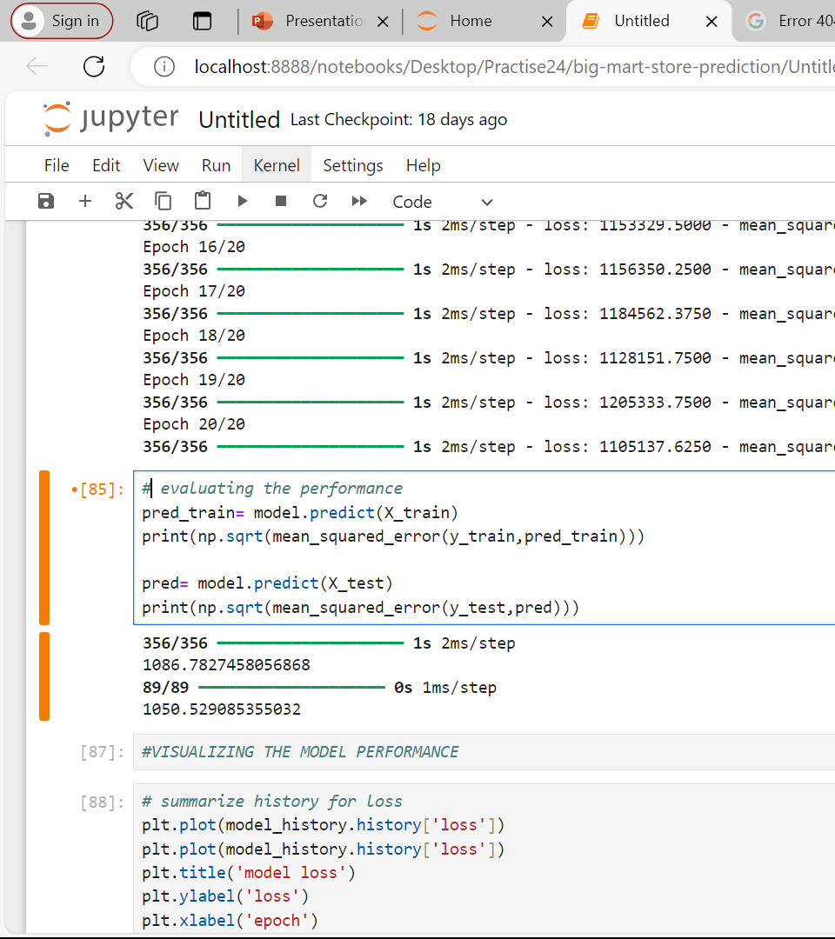
Evaluating the performance
print the RMSE for both the training and testing sets, allowing you to evaluate the performance of your trained model on unseen data
This line calculates the root mean squared error (RMSE) between the actual target variable values (y_test) and the predicted values (pred) for the testing set.

Slide 48
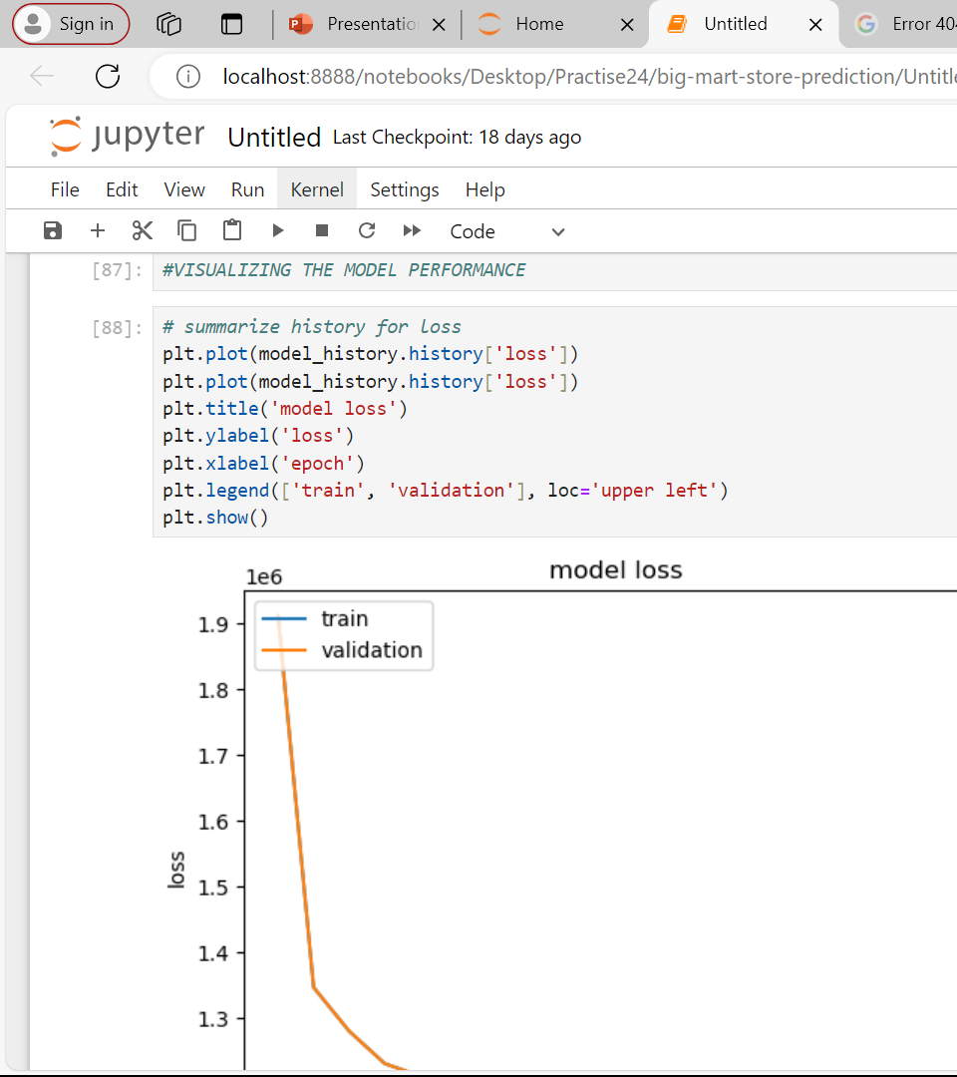
Summarise history for loss
This plot allows you to visualize the training and validation loss over epochs, helping you to monitor the training process and detect overfitting or underfitting.

Slide 49
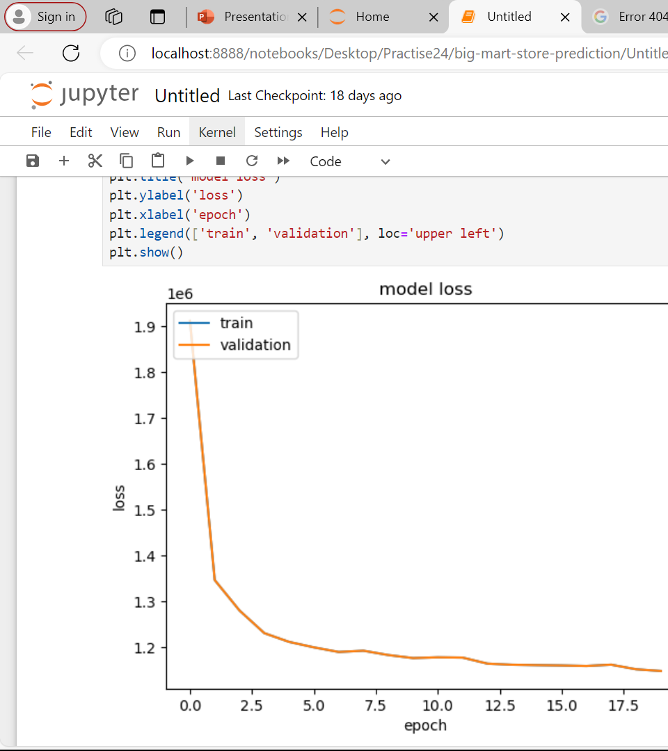
Model loss

